Slide 1
A phylogenomic investigation of Scutellaria reveals distinct patterns in medicinal flavonoid diversity
Bryce Askey¹, Yeong Hun Song¹, Yoonkyung Lee², Ru Dai¹, Sangtae Kim², and Jeongim Kim^{1,3}
¹Horticultural Sciences Department, University of Florida, Gainesville, FL, USA
²Department of Biology, Sungshin Women’s University, Seoul, Republic of Korea
³Plant Molecular and Cellular Biology Graduate Program, University of Florida, Gainesville, FL, USA

Slide 2
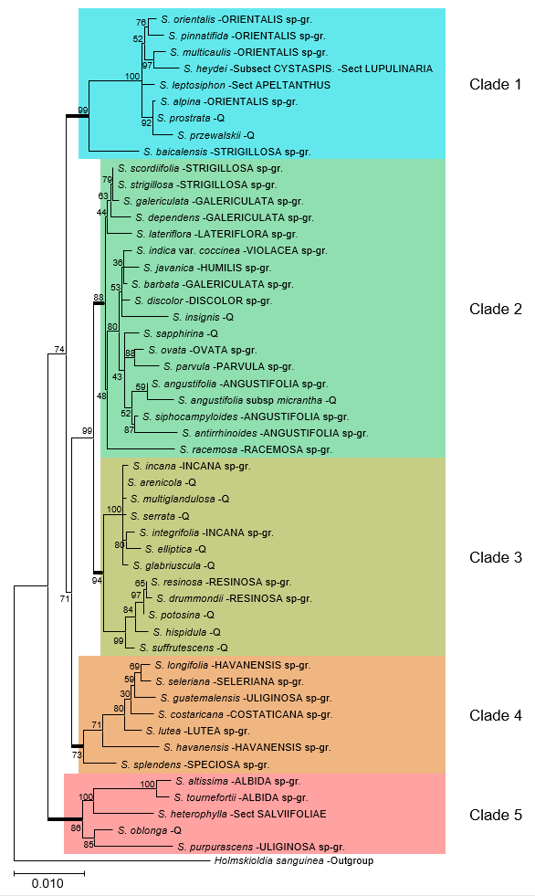
Figure 1. (A) Maximum likelihood phylogenetic tree inferred from 3 chloroplast genomic regions for 51 species of Scutellaria and 1 outgroup. To facilitate downstream analysis, the tree was subdivided into 5 color-coded clades.

Slide 3
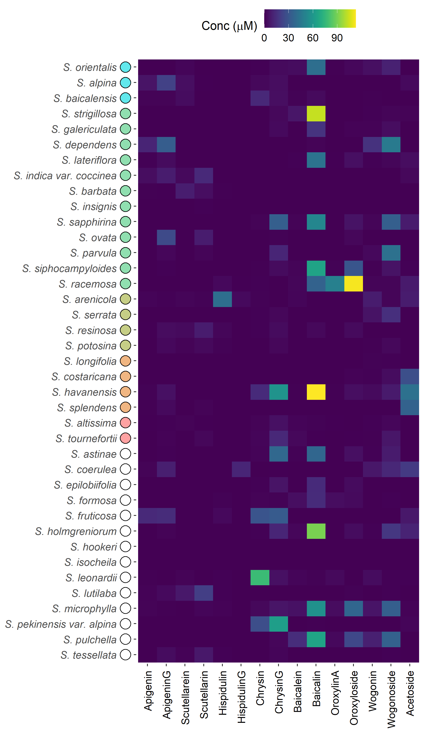
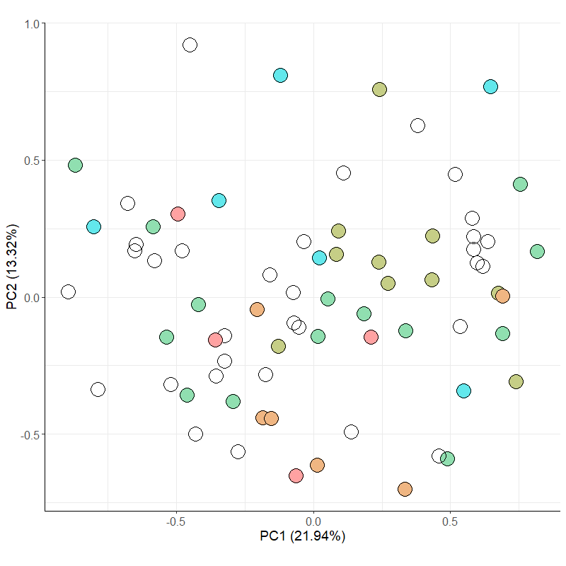
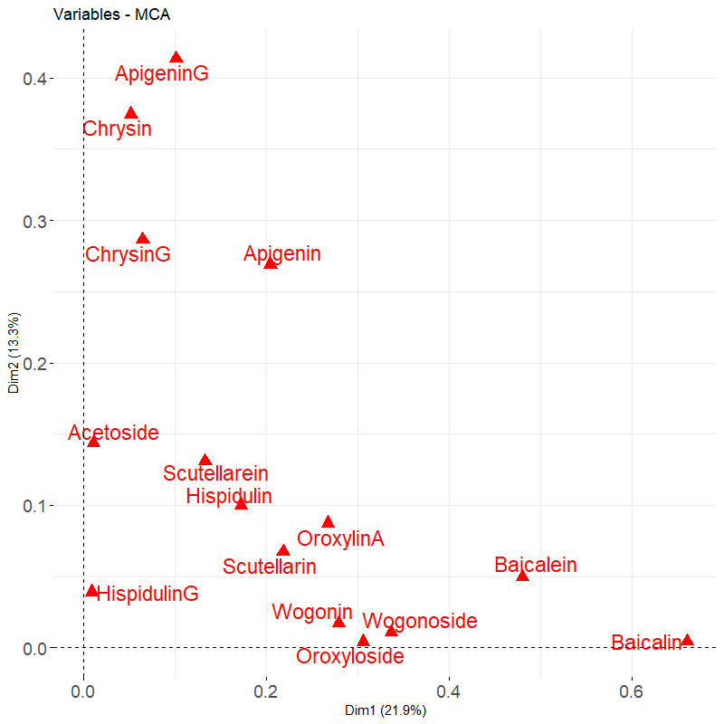
A.
B.
C.
Figure 2. Aerial flavonoid concentrations measured with High Performance Liquid Chromatography (HPLC) for # species of Scutellaria. (A) Heatmap of collected data. Colored circles next to species names indicate phylogenetic clade, as shown in Figure 1. An empty circle indicates that the species was not included in the tree from Figure 1. Data for fresh tissue samples is shown at 5000 ppm (5 mg sample / 1 mL solvent). Data for herbarium tissue samples is shown at 500 ppm (0.5 mg sample / 1 mL solvent). (B) Multiple Correspondance Analysis (MCA) results generated from binary version of flavonoid data. (C) Variable representations from MCA.

Slide 4
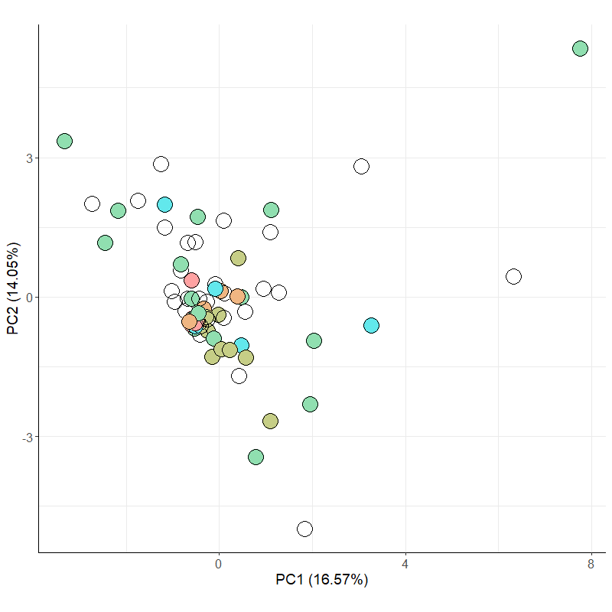
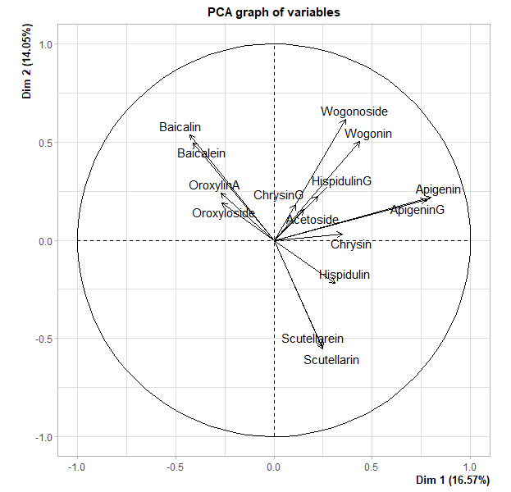
A.
B.
C.
Figure 2. Aerial flavonoid concentrations measured with High Performance Liquid Chromatography (HPLC) for # species of Scutellaria. (A) Heatmap of collected data. Colored circles next to species names indicate phylogenetic clade, as shown in Figure 1. An empty circle indicates that the species was not included in the tree from Figure 1. Data for fresh tissue samples is shown at 5000 ppm (5 mg sample / 1 mL solvent). Data for herbarium tissue samples is shown at 500 ppm (0.5 mg sample / 1 mL solvent). (B) Multiple Correspondance Analysis (MCA) results generated from binary version of flavonoid data. (C) Variable representations from MCA.

Slide 5
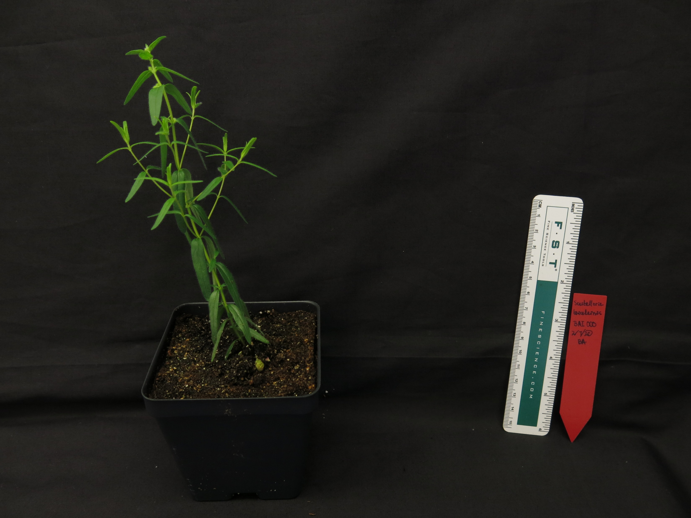
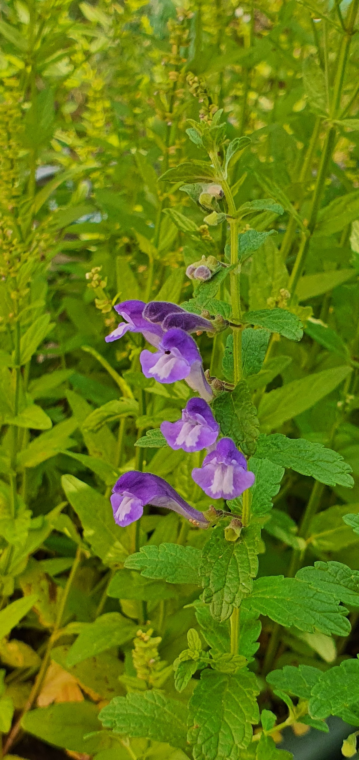
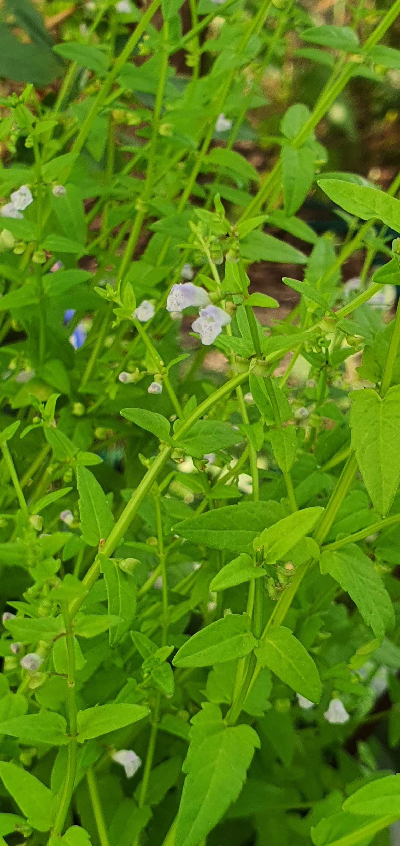
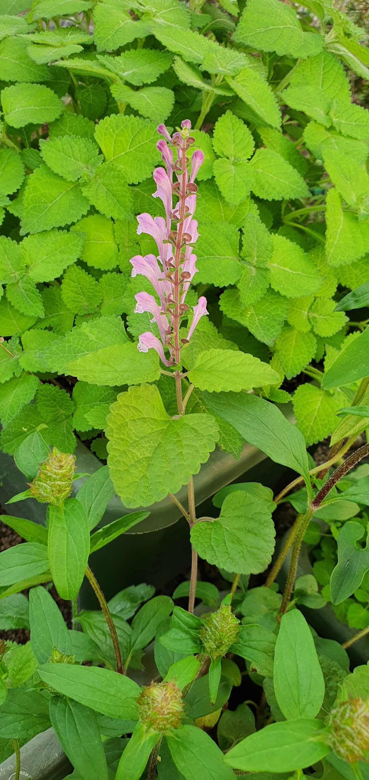
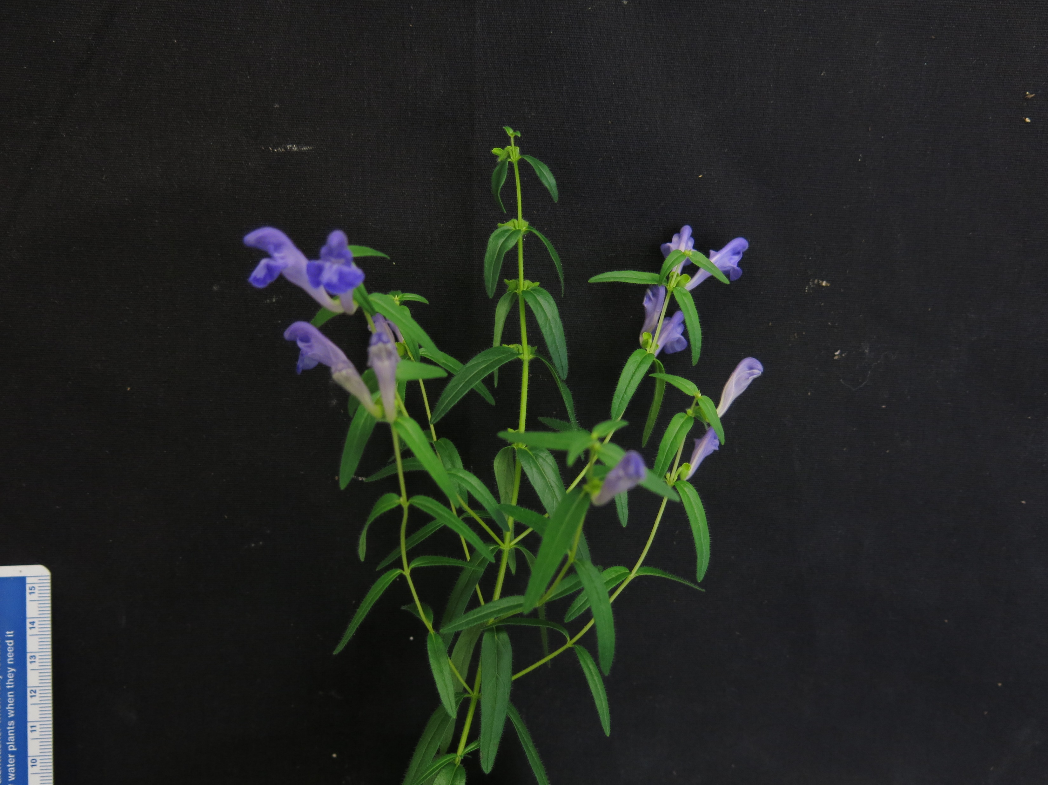
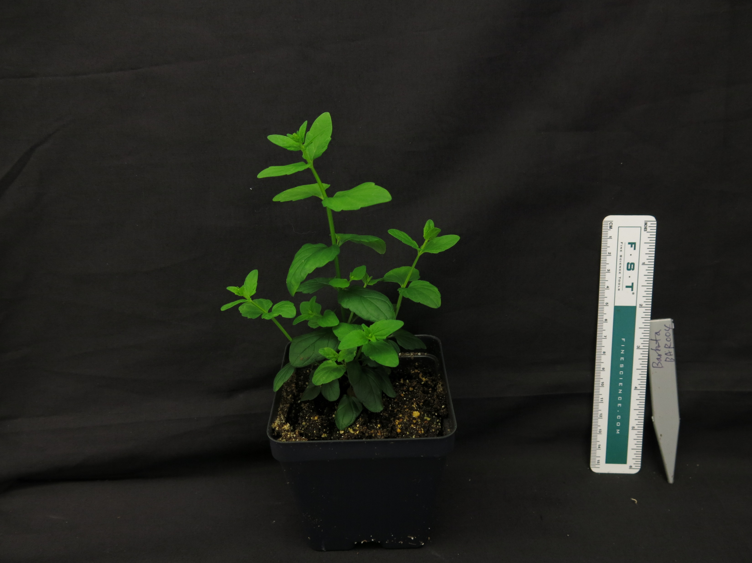
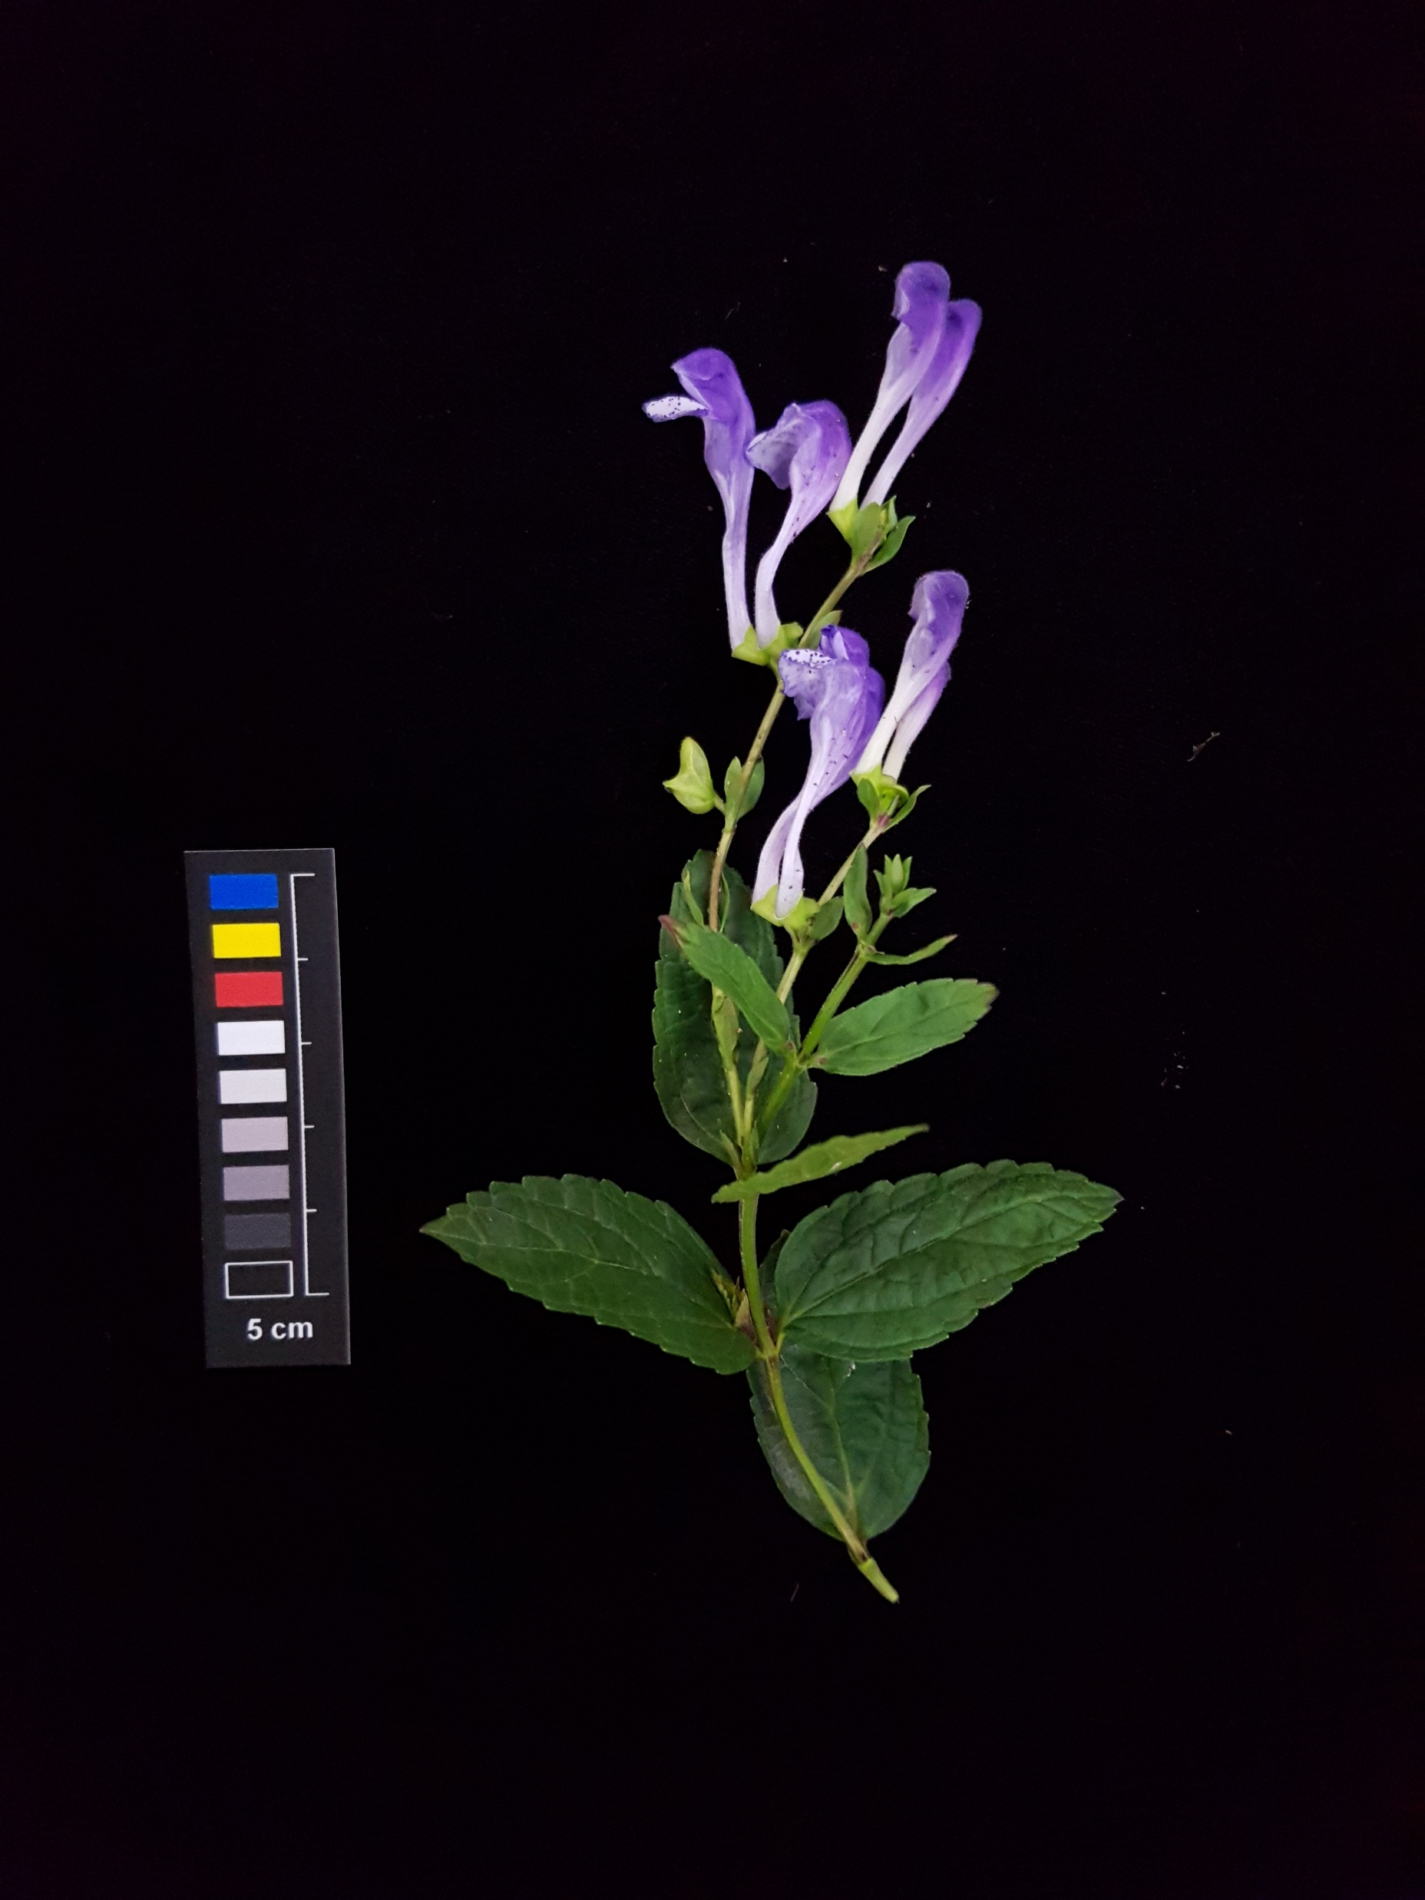
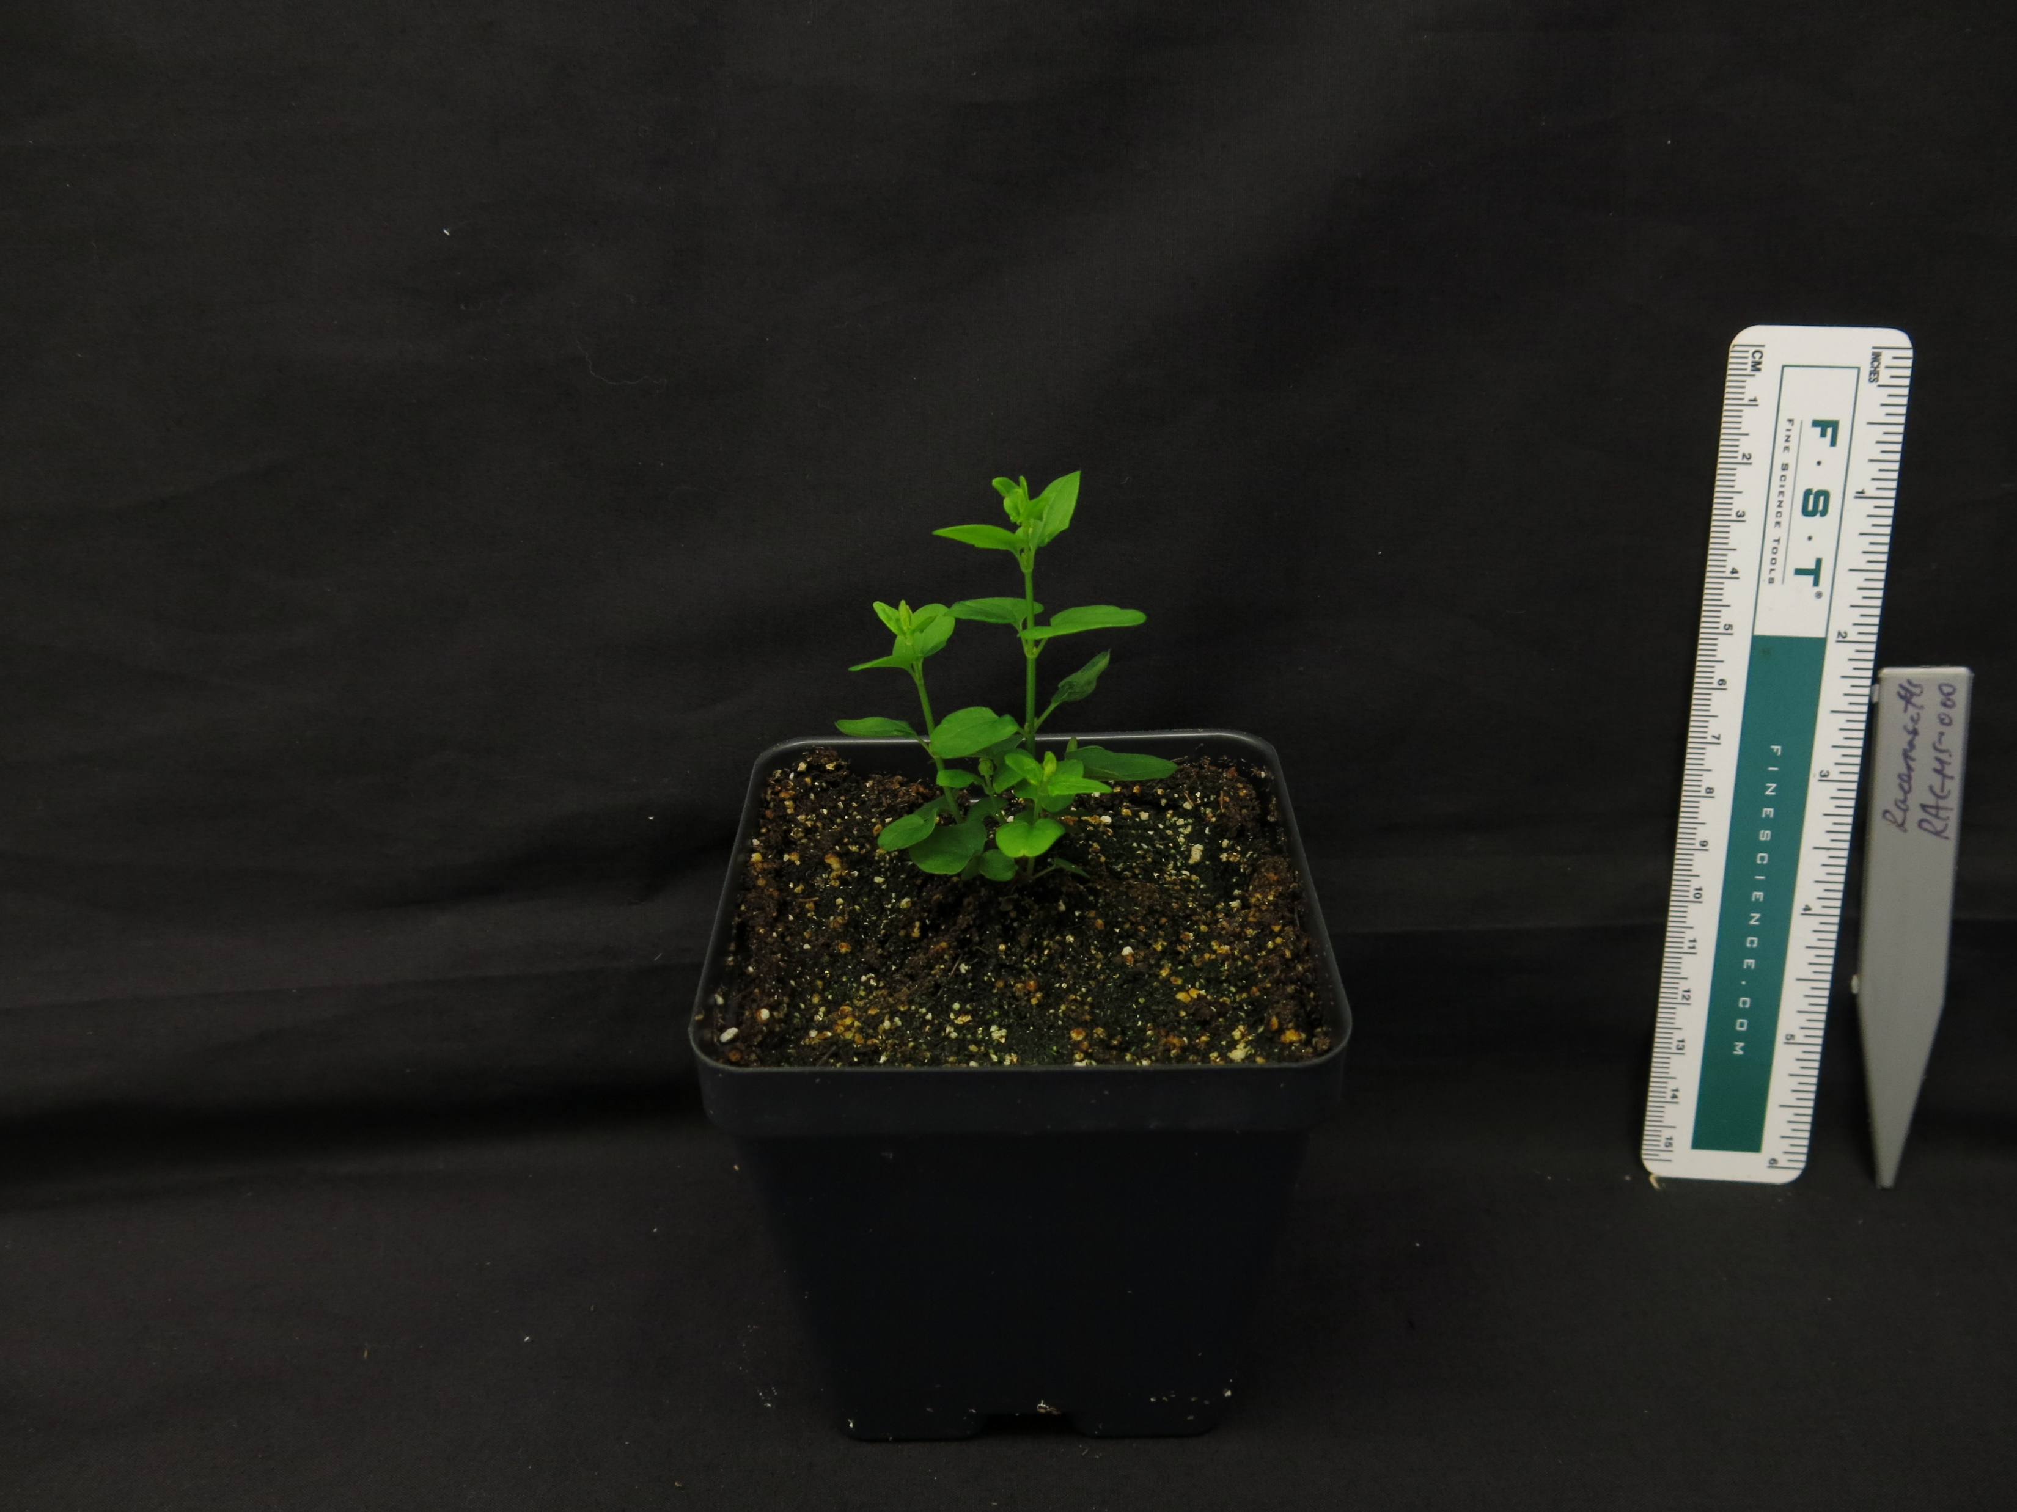
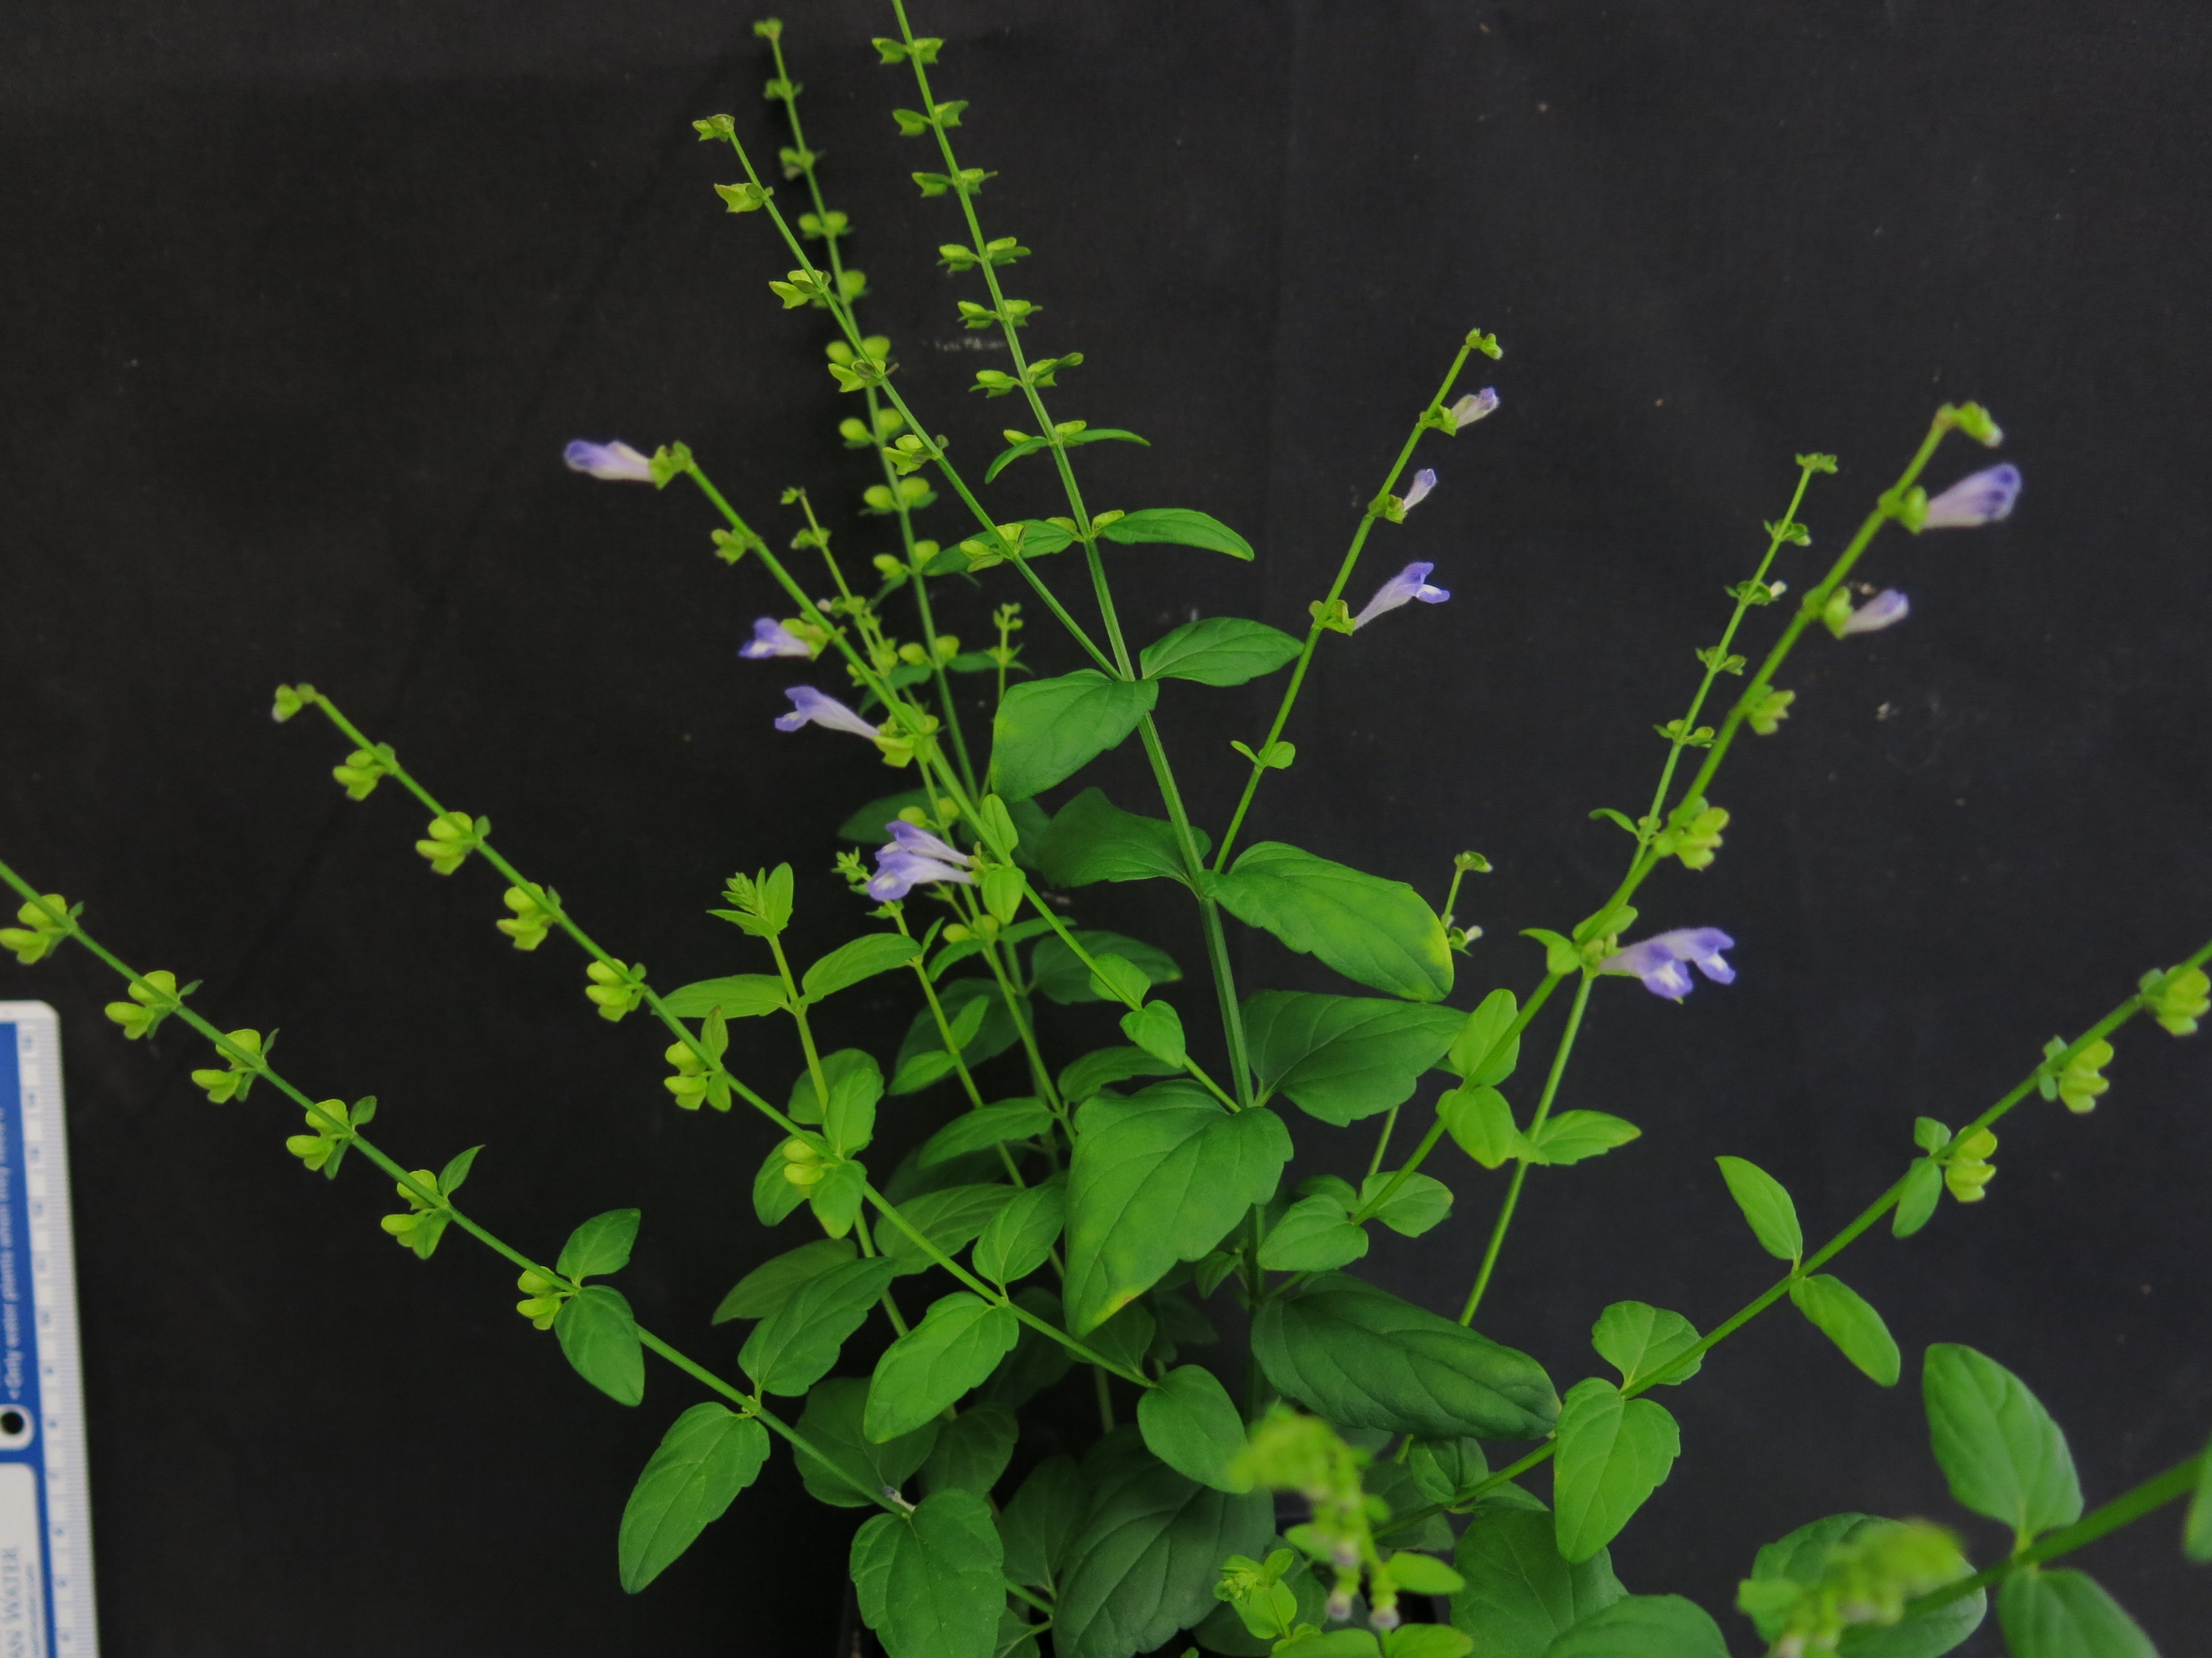
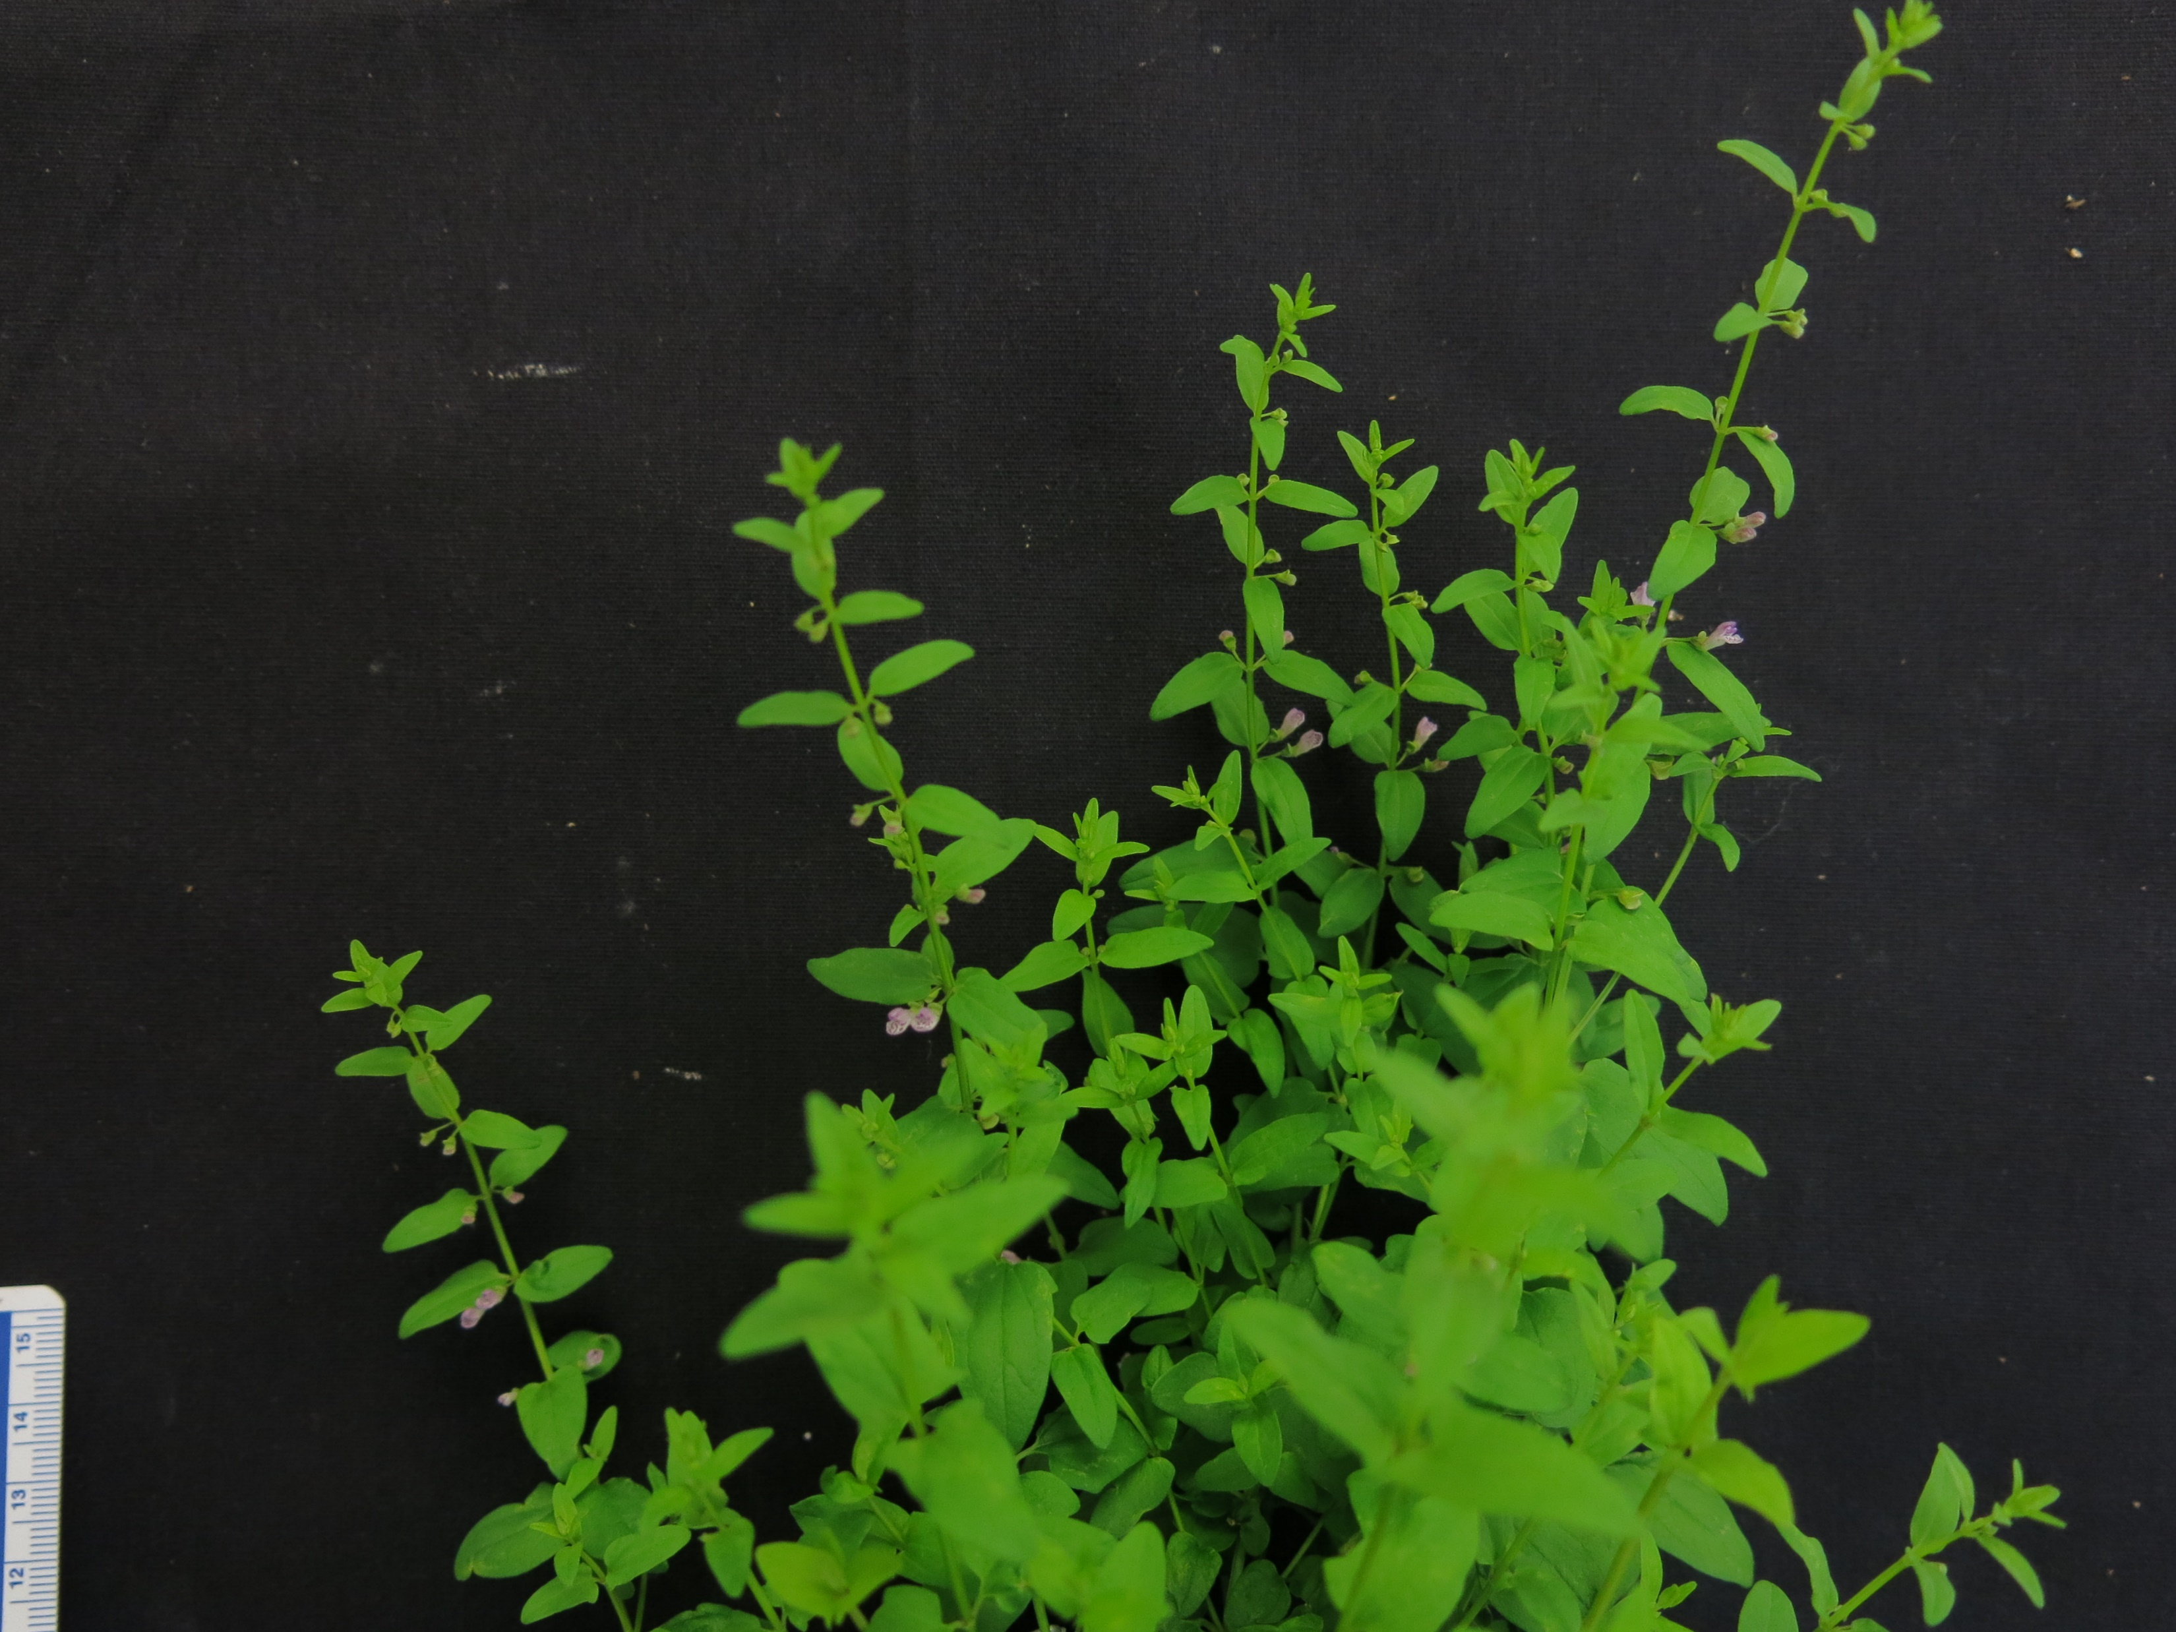
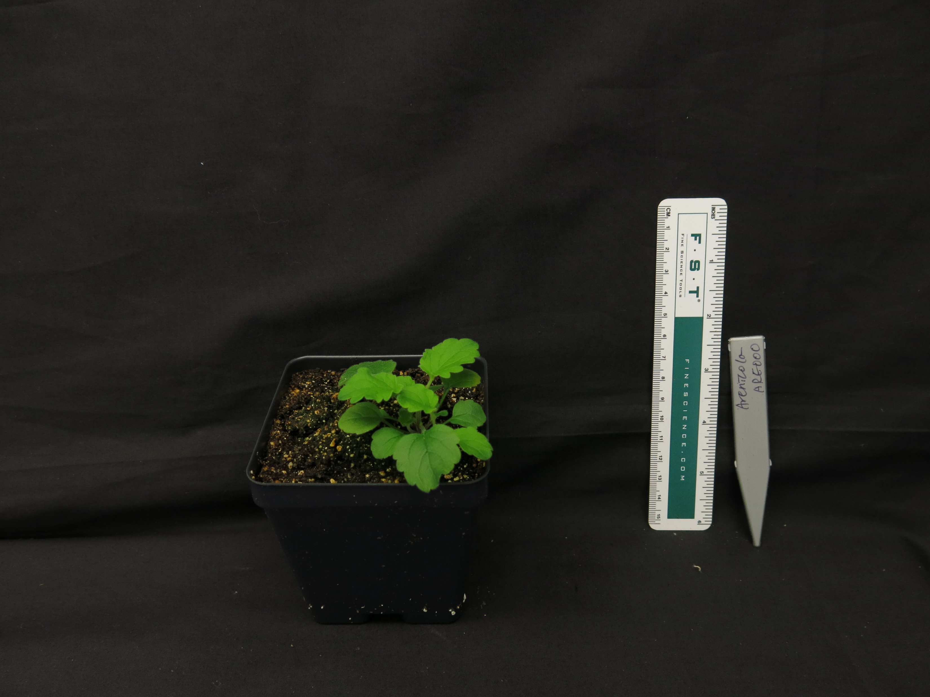
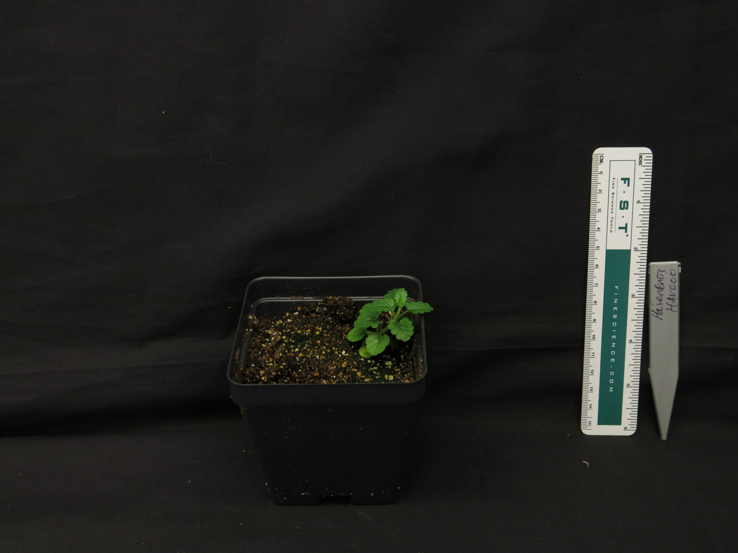
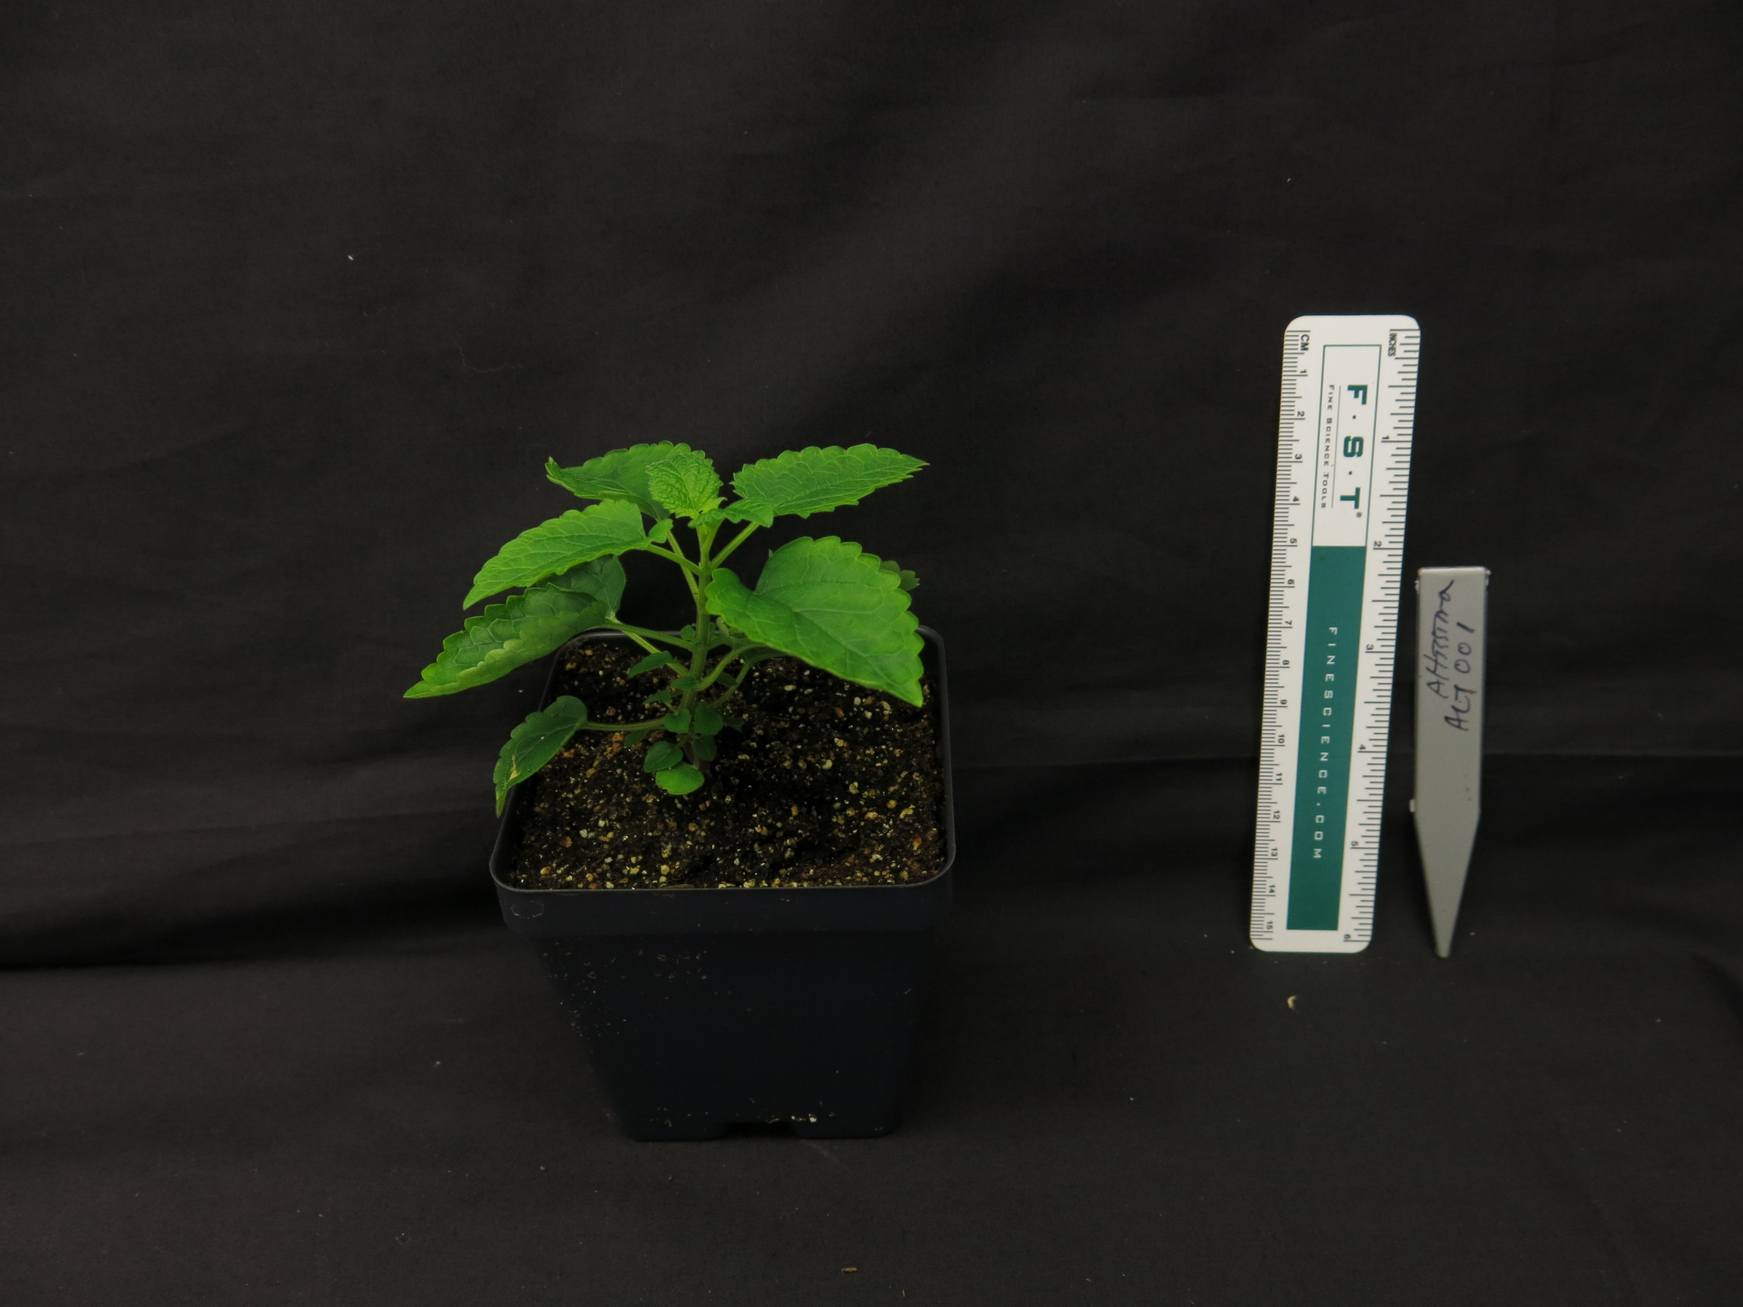
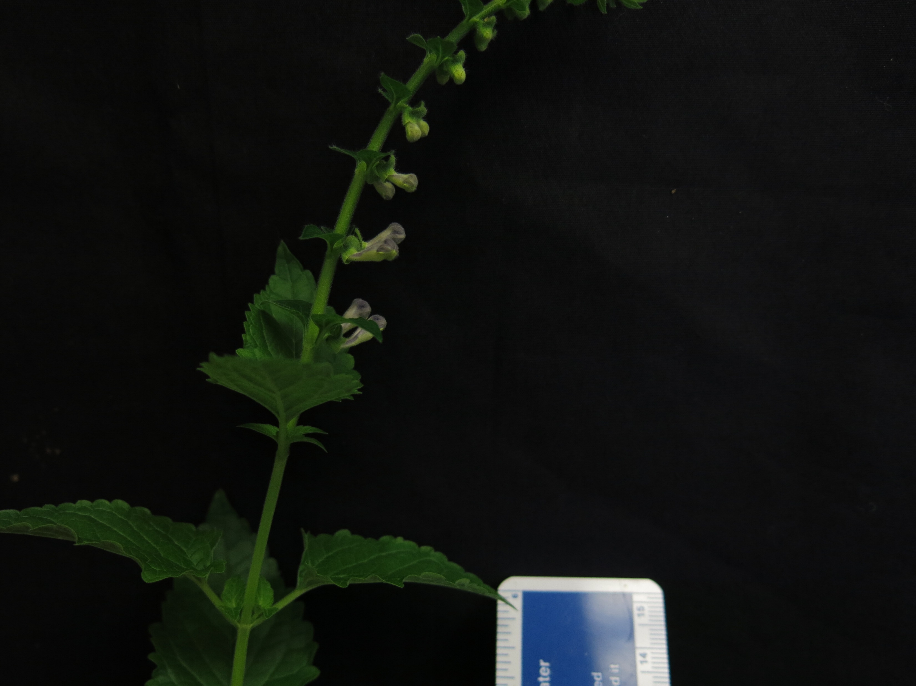
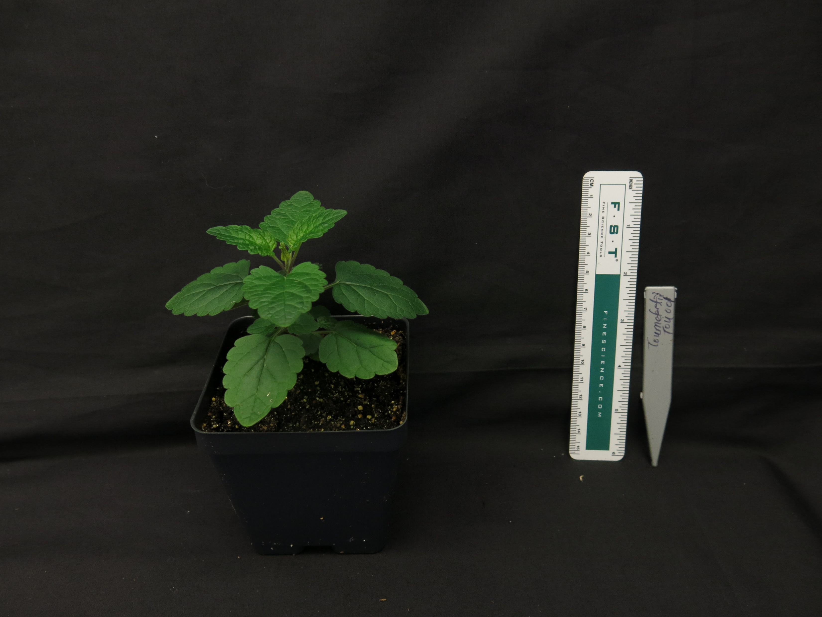
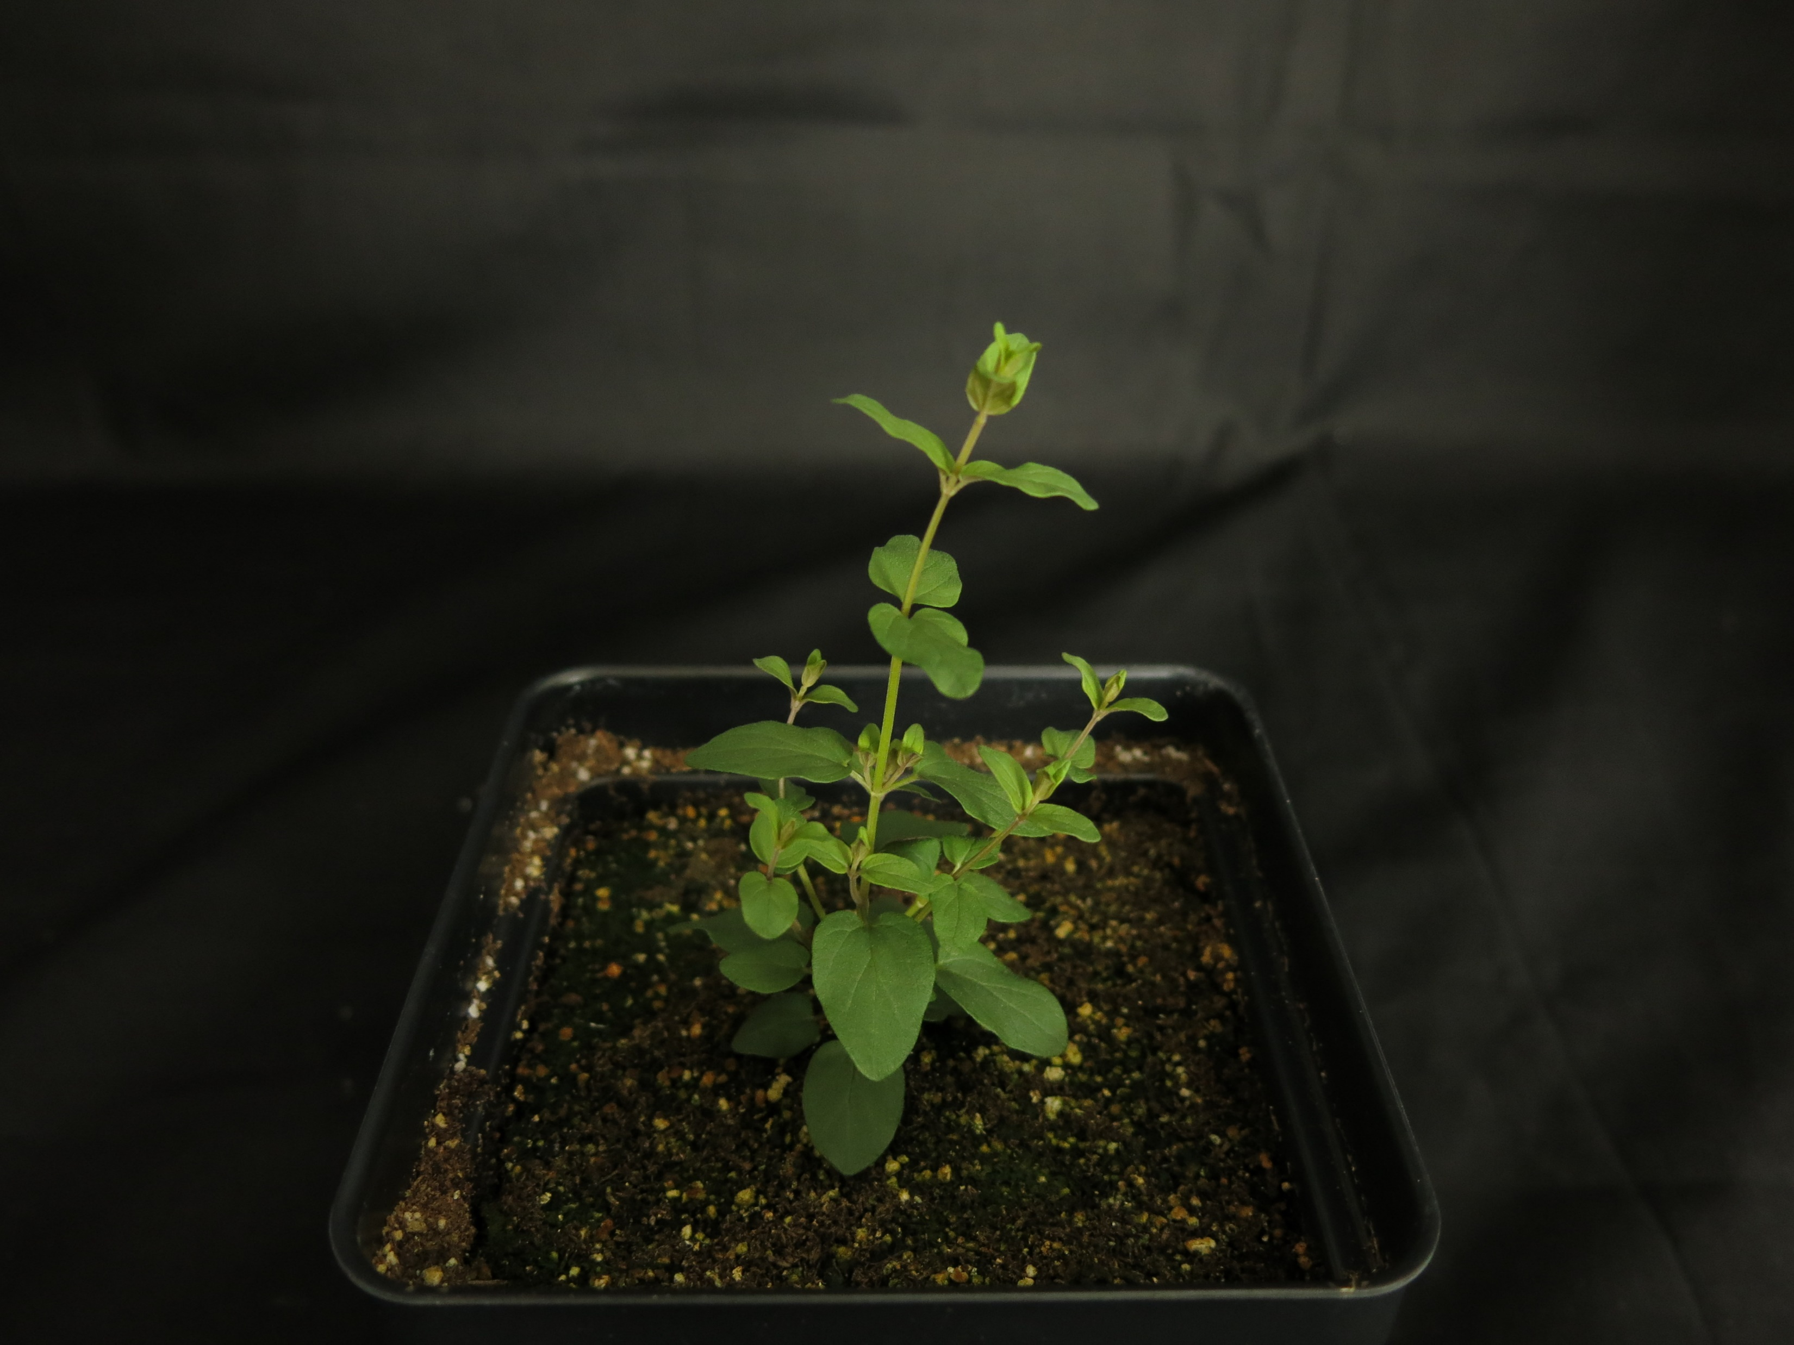
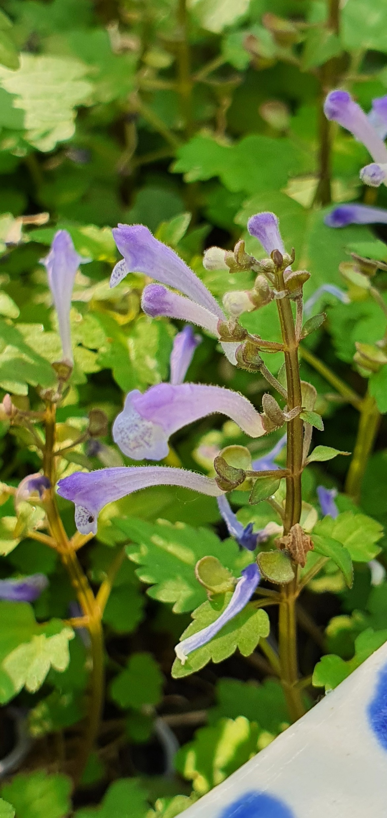
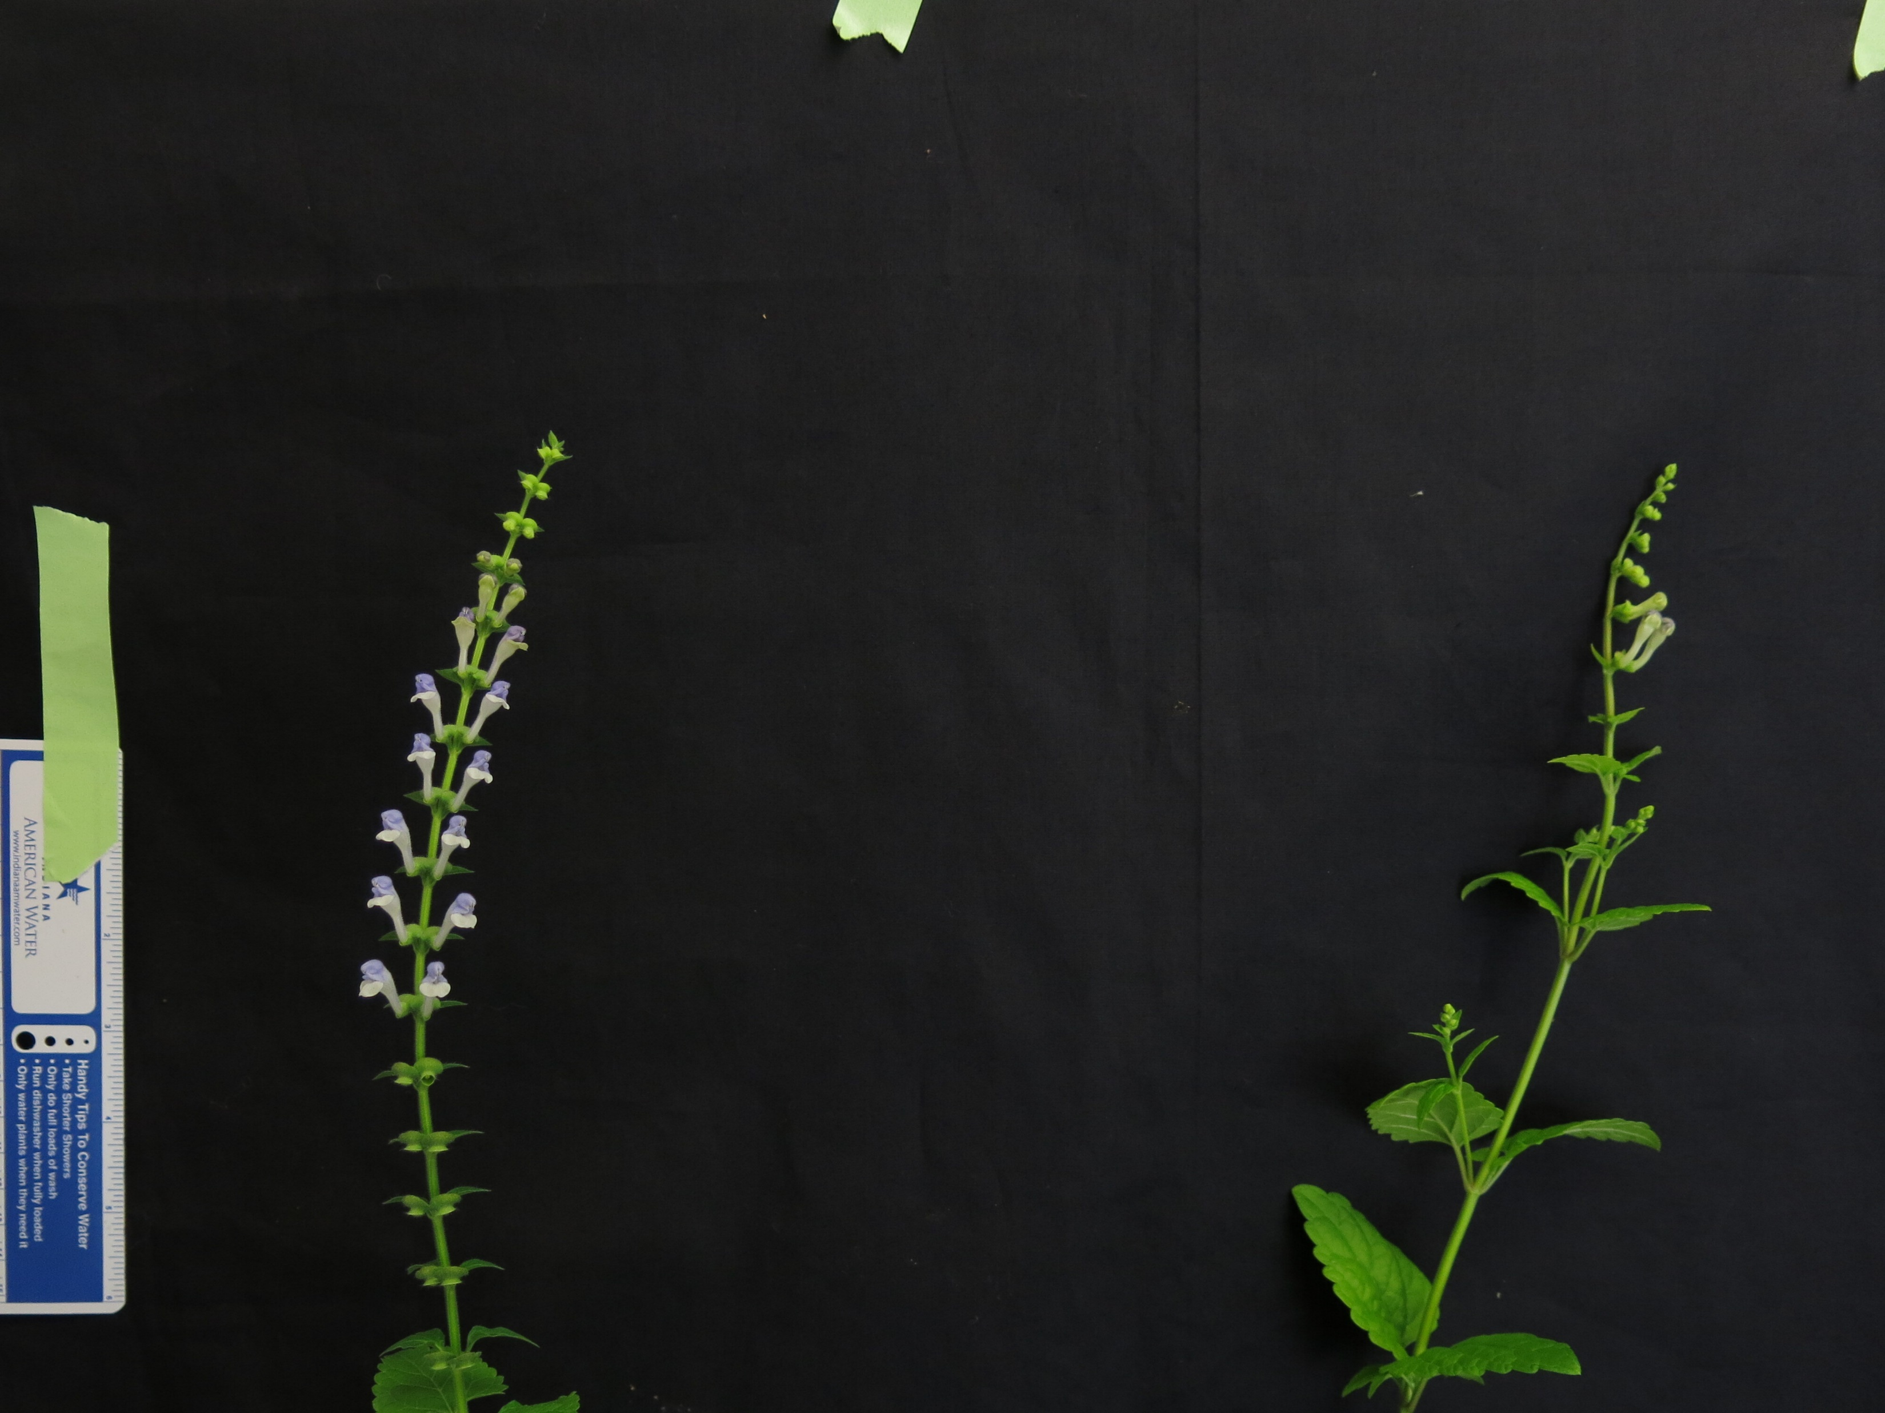
S. baicalensis
S. strigillosa
S. dependens
S. indica var. coccinea
S. barbata
S. insignis
S. racemosa
S. arenicola
S. havanensis
S. altissima
S. tournefortii
S. leonardii
S. pekinensis var. alpina
Figure 3. Representative images of 13 species of Scutellaria selected for additional flavonoid and genome size profiling. Scale bar in bottom left of images represents a length of 5 cm. Images without a scale bar didn’t have a ruler included in the image. Colored circles next to species names indicate the clade which the species belongs to.

Slide 6
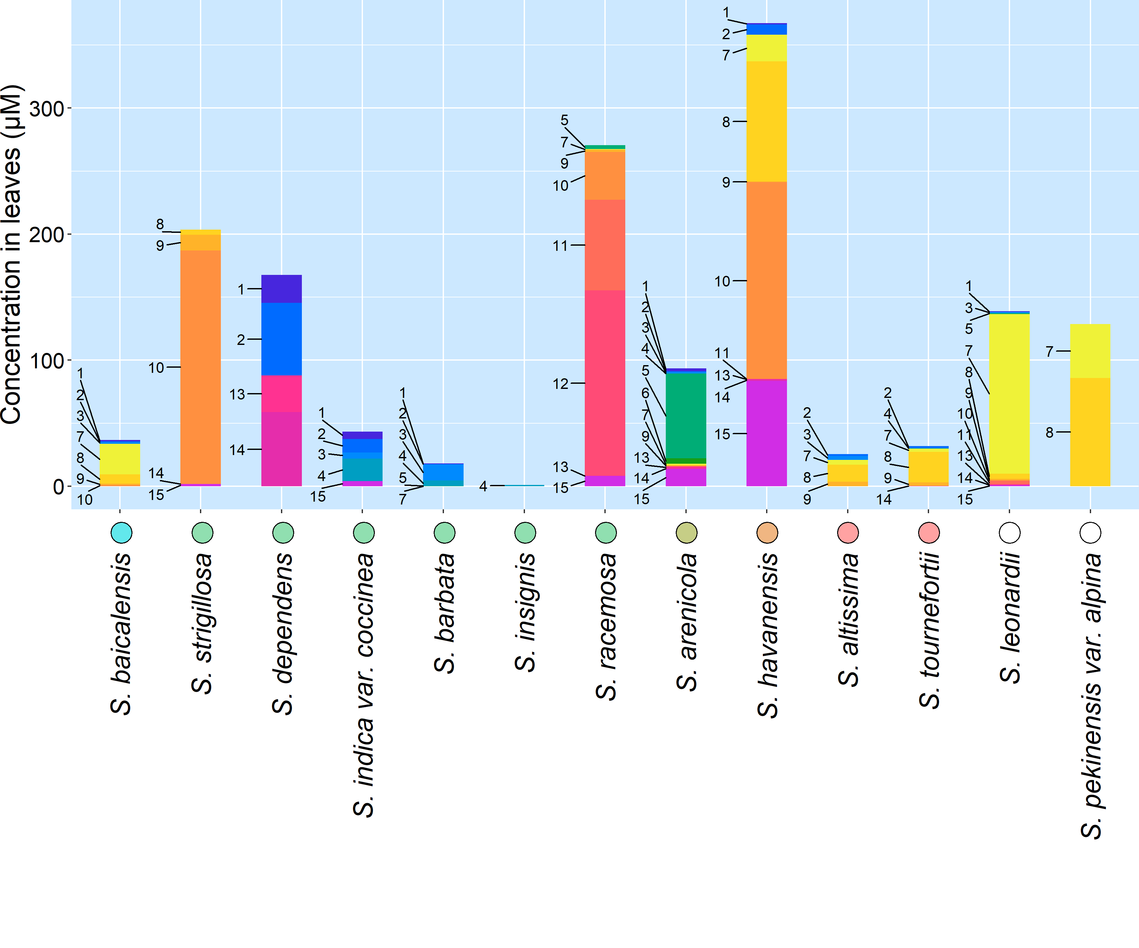
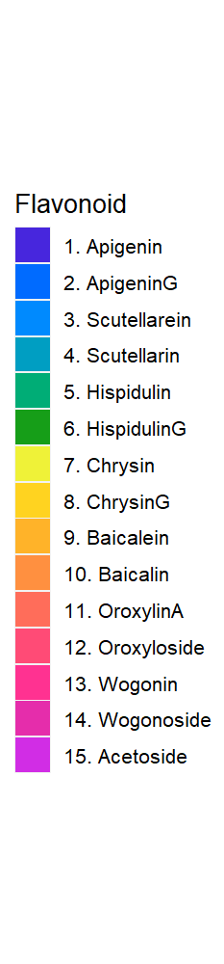
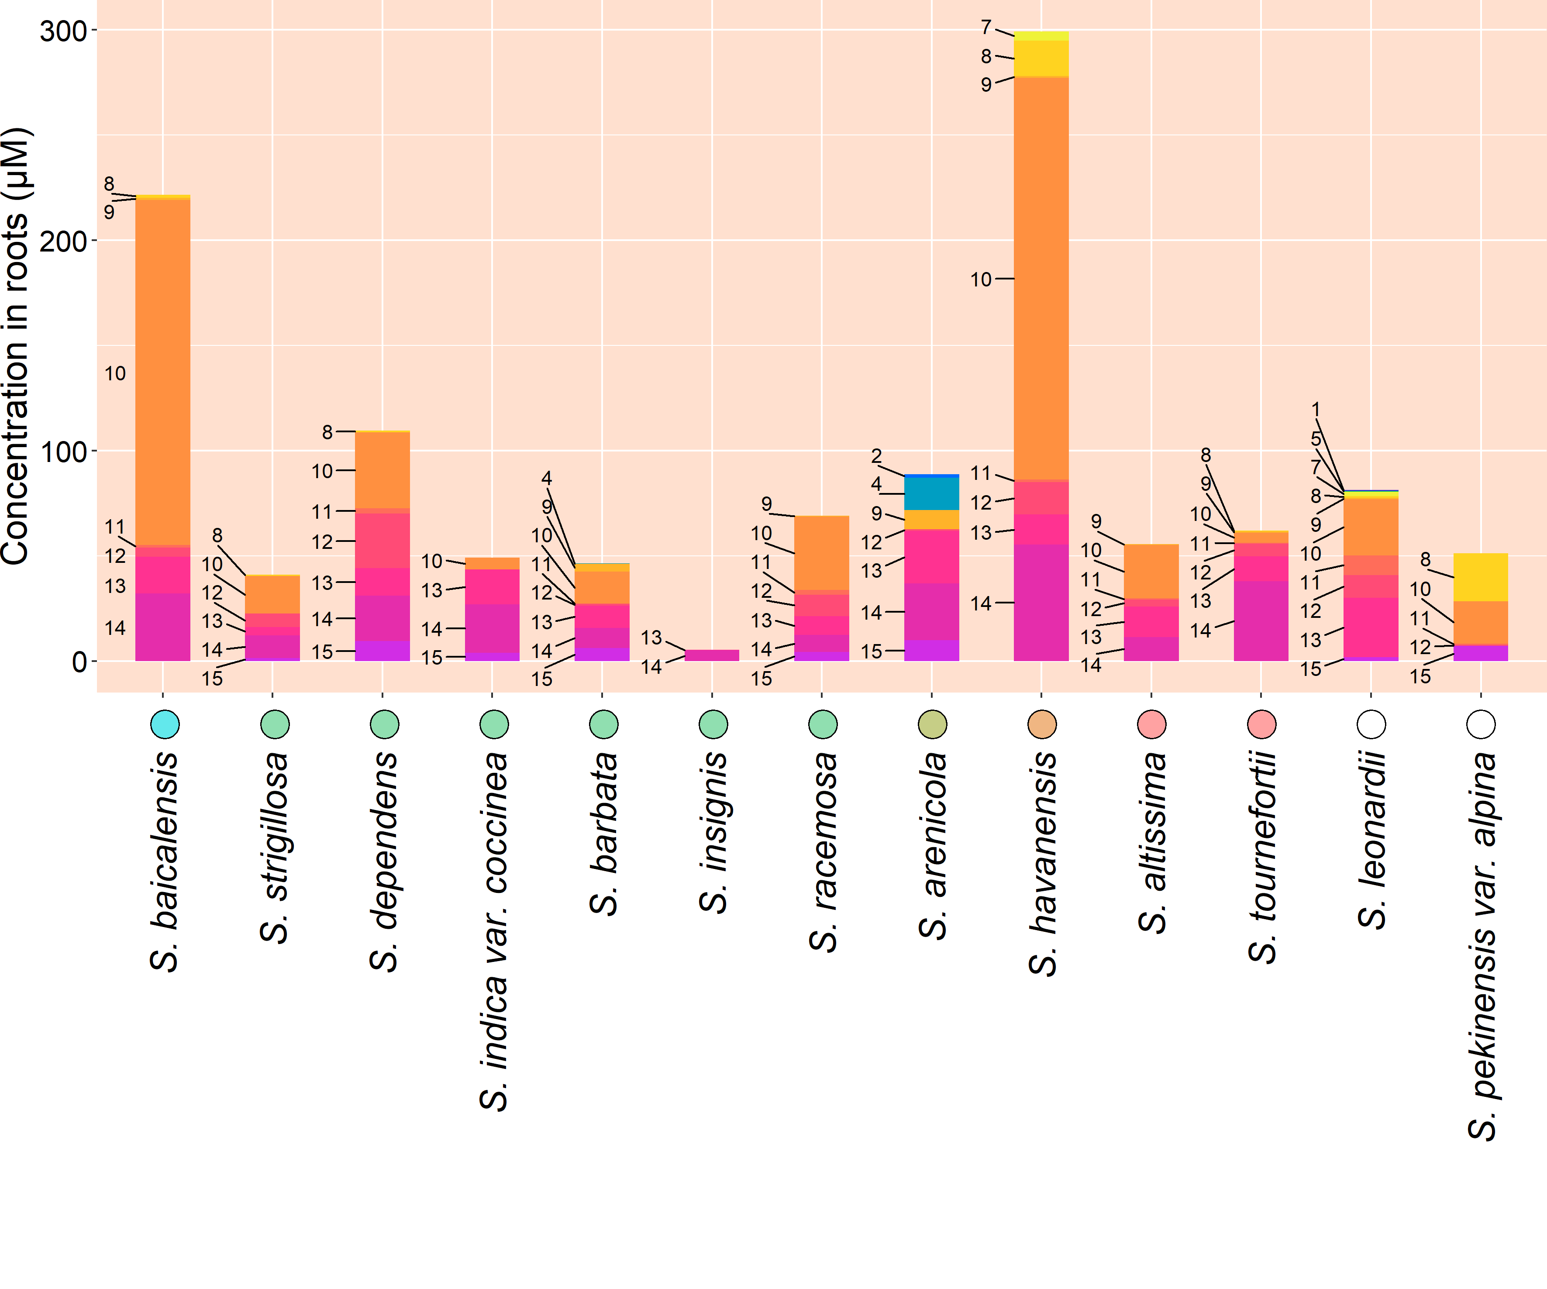
Figure 3. Organ-specific flavonoid data collected from 13 Scutellaria species via High Performance Liquid Chromatography (HPLC). Species are ordered based on phylogenetic relationship determine from chloroplast genome data, shown in Figure 1. Colored circles next to species names indicate phylogenetic clade, as shown in Figure 1. An empty circle indicates that the species was not included in the tree from Figure 1. Flavonoids are ordered based on proposed flavonoid pathway for S. baicalensis.

Slide 7
Table 1. Genome sizes as estimated by flow cytometry. Cell colors indicate phylogenetic clade, as shown in Figure 1.
Species | Estimated genome size (Gbp) |  | Chromosome number
 | Measured in this study | Published previously | Published previously
S. baicalensis | 0.54 | 0.38 (Xu et al., 2020) | 2n = 18 (Xu et al., 2020)
 |  | 0.41 (Zhao et al., 2019) | 2n = 18 (Zhao et al., 2019)
 |  | 0.41 (Cole et al., 2008)
S. strigillosa |  | 0.38 (Lee & Kim, 2017)
S. dependens | 0.44
S. indica var. coccinea |  | 0.38 (Lee & Kim, 2017)
S. barbata | 0.52 | 0.35 (Xu et al., 2020) | 2n = 26 (Xu et al., 2020)
S. insignis |  | 0.46 (Lee & Kim, 2017)
S. racemosa | 0.44 | 0.37 (Cole et al., 2008) | 2n = 18 (Cole et al., 2008)
S. arenicola | 0.85
S. havanensis | 0.37
S. altissima | 0.39
S. tournefortii | 0.39
S. leonardii | 0.50
S. pekenensis var. alpina | 0.38

Slide 8
Table S1. Source of Scutellaria tissue samples
 | Species | Condition | Organ | Herbarium | Voucher label
1 | S. alpina | Dried | Leaf, stem | Steere Herbarium, NY, USA | T. H. Everett s. n. (NY)
2 | S. altissima | Dried | Leaf | Steere Herbarium, NY, USA | M. Churadze 1007 (NY)
3 |  | Fresh | Leaf, stem, root | To be submitted | Herbarium name not recognized
4 | S. angulosa | Dried |  | Steere Herbarium, NY, USA | K. M. Naid s. n. (NY)
5 | S. angustifolia ssp. angustifolia | Dried |  | Steere Herbarium, NY, USA | R. Olmstead 558 (NY)
6 | S. angustifolia ssp. micrathum | Dried |  | Steere Herbarium, NY, USA | A. Tiehm 16758 (NY)
7 | S. antirrhinoides | Dried |  | Steere Herbarium, NY, USA | N. D. Atwood 28625 (NY)
8 | S. arenicola | Dried |  | University of Florida Herbarium, FL, USA | (FLAS)
9 |  | Fresh | Leaf, stem, root | To be submitted | Herbarium name not recognized
10 | S. astinae | Dried | Leaf, stem | Steere Herbarium, NY, USA | J. T. Howell 38532 (NY)
11 | S. baicalensis | Fresh | Leaf, stem, root | To be submitted | Herbarium name not recognized
12 | S. barbata | Fresh | Leaf, stem, root | To be submitted | Herbarium name not recognized
13 |  | Fresh | Leaf, stem, root | Sungshin Herbarium, Seoul, Republic of Korea | S. Kim 2019-056 (SWU)
14 | S. blepharophylla | Dried |  | Steere Herbarium, NY, USA | G. B. Hinton 1086 (NY)
15 | S. brittonii | Dried |  | Steere Herbarium, NY, USA | S. P. Churchill 7376 (NY)
16 | S. californica | Dried |  | Steere Herbarium, NY, USA | R. Olmstead 434 (NY)
17 | S. coccinea | Dried |  | Steere Herbarium, NY, USA | D. Cardenas et al. 42257 (NY)
18 | S. coerulea | Dried | Leaf | Steere Herbarium, NY, USA | T. S. Quedensley 10037 (NY)
19 | S. costaricana | Dried | Leaf, stem | Steere Herbarium, NY, USA | A. Cronquist 8834 (NY)
20 | S. dependens | Fresh | Leaf, stem, root | Sungshin Herbarium, Seoul, Republic of Korea | S. Kim 2019-065 (SWU)
21 | S. discolor | Dried |  | Steere Herbarium, NY, USA | A. A. Bullock 740 (NY)
22 | S. drumondii | Dried |  | Steere Herbarium, NY, USA | L. C. Higgins 17229 (NY)
23 | S. elliptica | Dried |  | University of Florida Herbarium, FL, USA | (FLAS)
24 | S. epilobiifolia | Dried | Leaf, stem | Steere Herbarium, NY, USA | C. E. Garton 22860 (NY)
25 | S. formosa | Dried | Leaf, stem | Steere Herbarium, NY, USA | H. et al. 11073 (NY)
26 | S. fruticosa | Dried | Leaf | Steere Herbarium, NY, USA | H. Field & Y. Lazar s. n. (NY)
27 | S. galericulata | Dried | Leaf, stem | Steere Herbarium, NY, USA | D. Erskine & A. J. Smith 2118 (NY)
28 | S. glabriuscula | Dried |  | Steere Herbarium, NY, USA | R. Kral s. n. (NY)
29 | S. guatemalensis | Dried |  | Steere Herbarium, NY, USA | D. Alvarez 11028 (NY)
30 | S. havanensis | Dried |  | Steere Herbarium, NY, USA | J. K. Small s. n. (NY)
31 |  | Fresh | Leaf, stem, root | To be submitted | Herbarium name not recognized
32 | S. heterophylla | Dried |  | Steere Herbarium, NY, USA | A. Bertschinger s. n. (NY)
33 | S. heydei | Dried |  | Steere Herbarium, NY, USA | W. Koelz 6242 (NY)
34 | S. hispidula | Dried |  | Steere Herbarium, NY, USA | R. D. Worthington 12501 (NY)
35 | S. holmgreniorum | Dried | Leaf, stem | Steere Herbarium, NY, USA | G. Schoolcraft 1222 (NY)
36 | S. hookeri | Dried | Leaf, stem | Steere Herbarium, NY, USA | L. O. Willioms et al. 28585 (NY)
37 | S. incanca | Dried |  | Steere Herbarium, NY, USA | R. D. Thomas 150388 (NY)
38 | S. indica var. coccinea | Fresh | Leaf, stem, root | Sungshin Herbarium, Seoul, Republic of Korea | S. Kim & S. T. Lee 2015-0298 (SWU)
39 | S. insignis | Fresh | Leaf, stem, root | Sungshin Herbarium, Seoul, Republic of Korea | S. Kim 2015-0110 (SWU)
40 | S. integrifolia | Dried |  | University of Florida Herbarium, FL, USA | (FLAS)
41 | S. isochelia | Dried | Leaf, stem | Steere Herbarium, NY, USA | A. M. Brenes s. n. (NY)
42 | S. javalambrensis | Dried |  | Steere Herbarium, NY, USA | A. Charpin et al. s. n. (NY)
43 | S. javanica | Dried |  | Steere Herbarium, NY, USA | S. K. Lau 1915 (NY)
44 | S. lateriflora | Dried | Leaf | Steere Herbarium, NY, USA | G. F. Buddell II 2352 (NY)
45 |  | Fresh | Leaf, stem, root | To be submitted | Herbarium name not recognized
46 | S. leonardii | Dried |  | Steere Herbarium, NY, USA | J. C. Arthwz s. n. (NY)
47 |  | Fresh | Leaf, stem, root | To be submitted | Herbarium name not recognized
48 | S. leptosiplonsipkon | Dried |  | Steere Herbarium, NY, USA | L. Maplcoba s. n. (NY)
49 | S. longifolia | Dried | Leaf, stem | Steere Herbarium, NY, USA | J. J. Castillo & J. M. Vargas 2722 (NY)
50 | S. lutea | Dried |  | Steere Herbarium, NY, USA | Jorge A. Molina 30005 (NY)
51 | S. lutilaba | Dried | Leaf, stem | Steere Herbarium, NY, USA | Hinton et al. 21760 (NY)
52 | S. microphylla | Dried | Leaf, stem, root | Steere Herbarium, NY, USA | H. D. Ripley 14966 (NY)
53 | S. multicularis | Dried |  | Steere Herbarium, NY, USA | Assadi, Edmondson & Miller 2135 (NY)
54 | S. multiglandulosa | Dried |  | Steere Herbarium, NY, USA | D. S. Correll & H. B. Correll 51703 (NY)
55 | S. multiglandulosa | Dried |  | University of Florida Herbarium, FL, USA | (FLAS)
56 | S. muriculata | Dried |  | Steere Herbarium, NY, USA | C. L. Lundell 14978 (NY)
57 | S. oblonga | Dried |  | Steere Herbarium, NY, USA | L. H. Cramer 4871 (NY)
58 | S. orientalis | Dried | Leaf, stem | Steere Herbarium, NY, USA | E. Serowa & E. Ryschowa s. n. (NY)
59 | S. ovata | Dried | Leaf | Steere Herbarium, NY, USA | R. D. Thomas et al. 170488 (NY)
60 | S. parvula | Dried | Leaf, stem | Steere Herbarium, NY, USA | R. D. Thomas & C. Slaughter 103883 (NY)
61 | S. paucifolia | Dried |  | Steere Herbarium, NY, USA | P. Jaeger 8796 (NY)
62 | S. pekinensis var. alpina | Fresh | Leaf, stem, root | Sungshin Herbarium, Seoul, Republic of Korea | S. Kim 2015-0268 (SWU)
63 | S. peregrina | Dried |  | Steere Herbarium, NY, USA | H. Field & Y. Lazar s. n. (NY)
64 | S. pinnatifida | Dried |  | Steere Herbarium, NY, USA | K. H. Rechinger 686 (NY)
65 | S. potosina | Dried | Leaf, stem | Steere Herbarium, NY, USA | D. S. Correll & H. B. Correll 30562 (NY)
66 | S. prostrata | Dried |  | Steere Herbarium, NY, USA | W. Koelz 21180 (NY)
67 | S. przewalskii | Dried |  | Steere Herbarium, NY, USA | L. Janczenko s. n. (NY)
68 | S. pseudoserrata | Dried |  | Steere Herbarium, NY, USA | R. Kral s. n. (NY)
69 | S. pulchella | Dried | Root | Steere Herbarium, NY, USA | R. Schischkin et al. s. n. (NY)
70 | S. purpurascens | Dried |  | Steere Herbarium, NY, USA | A. M. Brenes s. n. (NY)
71 | S. racemosa | Dried |  | University of Florida Herbarium, FL, USA | (FLAS)
72 |  | Fresh | Leaf, stem, root | To be submitted | Herbarium name not recognized
73 | S. relenorskyi | Dried |  | Steere Herbarium, NY, USA | A. Donmez 3627 (NY)
74 | S. resinosa | Dried | Leaf, stem | Steere Herbarium, NY, USA | G. C. Freeman & R. E. Brooks 3682 (NY)
75 | S. sapphirina | Dried | Leaf, stem | Steere Herbarium, NY, USA | S. L. Welsh 20585 (NY)
76 | S. scordiifolia | Dried |  | Steere Herbarium, NY, USA | H. H. Iltis et al. 307 (NY)
77 | S. seleriana | Dried |  | Steere Herbarium, NY, USA | C. G. Pringle s. n. (NY)
78 | S. serrata | Dried | Leaf | Steere Herbarium, NY, USA | J. J. Carter s. n. (NY)
79 | S. siphocampuloides | Dried | Leaf, stem | Steere Herbarium, NY, USA | S. D. White 4380 (NY)
80 | S. splendens | Dried | Leaf | Steere Herbarium, NY, USA | A. Villegas H. 00063 (NY)
81 | S. strigillosa | Fresh | Leaf, stem, root | Sungshin Herbarium, Seoul, Republic of Korea | S. Kim 20140705 (SWU)
82 | S. suffrutscens | Dried |  | Steere Herbarium, NY, USA | J. L. Reveal 3390 (NY)
83 | S. sumatrana | Dried |  | Steere Herbarium, NY, USA | C. Hamel & R. S. Toroes 767 (NY)
84 | S. tessellata | Dried | Leaf, stem | Steere Herbarium, NY, USA | R. D. Worthington 13323 (NY)
85 | S. tournefortii | Fresh | Leaf, stem, root | To be submitted | Herbarium name not recognized

